Slide 1
Young Key Populations
Last updated: December 2019

Slide 2
HIV prevalence and epidemiology

Slide 3
ENDING AIDS BY 2030: Fast-Track and reduce new infections among young people by 2020
New HIV infections among young people (15-24) in Asia and the Pacific
2010
2018
2020
100,000 new HIV infections
82,000 new HIV infections
Target = 75% reduction
from 2010 baseline
Source: Prepared by www.aidsdatahub.org based on UNAIDS 2019 HIV estimates

Slide 4
Regional snapshot of HIV infections and AIDS-related deaths
HIV and AIDS in Asia and the Pacific, 2018
New HIV
infections
310,000
People living with HIV
5.9 million
Among young people (15-24 yr)…
390 000 are living with HIV
82 000 new HIV infections
4 600 died with AIDS-related illness
Women living with HIV
2.1 million
Young people living with HIV
390,000
Children living with HIV
110,000
Deaths
200,000
Source: Prepared by www.aidsdatahub.org based on UNAIDS 2019 HIV Estimates

Slide 5
HIV and AIDS among young people (15-24 yr) in Asia and the Pacific 2000-2018
2018 “zoom-in”
82,000
New HIV infections
390,000
Young people living with HIV
4,600
AIDS-related deaths
Young men
Young women
Source: Prepared by www.aidsdatahub.org based on UNAIDS 2019 HIV Estimates

Slide 6
10 countries* account for 98% of all new HIV infections among young people (15-24) in the region and trends diverse greatly in Asia and the Pacific countries
Percentage change in new HIV infections among young people (15-24) by country, 2010-2018
* PNG, Viet Nam, Malaysia, Thailand, Pakistan, Myanmar, China, Philippines, Indonesia, and India
Source: Prepared by www.aidsdatahub.org based on UNAIDS 2019 HIV Estimates
Notes:
9, 11, 29 ,30

Slide 7
Snapshot of young people and HIV infections in Asia and the Pacific, 2018
Young people 15-24 yr
Other populations
Number of new infections among young people
Young women 15-24 yr
Young men 15-24 yr
Source: Prepared by www.aidsdatahub.org based on UNAIDS 2019 HIV Estimates

Slide 8
390,000 young people (15-24) were living with HIV in 2018, 7% of people living with HIV in Asia and the Pacific
Young people living with HIV, 1990 - 2018
320,000 young female (15-24)
370,000 young male (15-24)
Source: Prepared by www.aidsdatahub.org based on UNAIDS 2019 HIV Estimates

Slide 9
Countries where HIV prevalence among young key populations (< 25 yr) is ≥5%, 2014-2018
* MSM age bracket is 20-24
Source: Prepared by www.aidsdatahub.org based on Global AIDS Response Progress Reporting; Global AIDS Monitoring Reporting; HIV Sentinel Surveillance Surveys and Integrated Biological and Behavioural Surveys

Slide 10
HIV prevalence among sex workers by age group, countries where data is available, 2012-2018
Source: Prepared by www.aidsdatahub.org based on Behavioural Surveys; Integrated Biological and Behavioural Surveys; Global AIDS Response Progress Reporting; Global AIDS Monitoring (GAM) reporting

Slide 11
HIV prevalence among men who have sex with men by age group, countries where data is available, 2012-2018
* Kathmandu
Source: Prepared by www.aidsdatahub.org based on Behavioural Surveys; Integrated Biological and Behavioural Surveys; Global AIDS Response Progress Reporting; Global AIDS Monitoring (GAM) reporting

Slide 12
HIV prevalence among transgender people by age group, countries where data is available, 2014-2018
Source: Prepared by www.aidsdatahub.org based on Behavioural Surveys; Integrated Biological and Behavioural Surveys; Global AIDS Response Progress Reporting; Global AIDS Monitoring (GAM) reporting

Slide 13
HIV prevalence among people who inject drugs by age group, countries where data is available, 2012-2018
*Sample size of young PWID from 2014 survey is very small to make comparison with older counterpart
Source: Prepared by www.aidsdatahub.org based on Behavioural Surveys; Integrated Biological and Behavioural Surveys; Global AIDS Response Progress Reporting; Global AIDS Monitoring (GAM) reporting

Slide 14
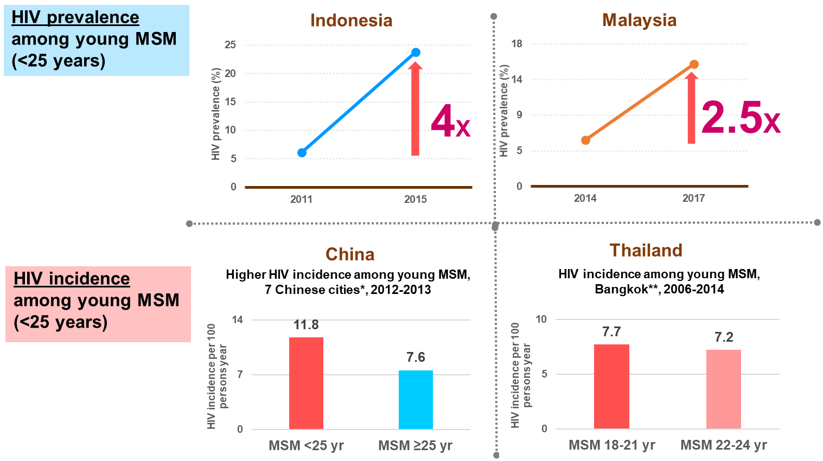
Rising HIV infections among young MSM: common denominator in counties with different epidemic dynamics
*Shanghai, Nanjing, Changsha, Zhengzhou, Ji’nan, Shenyang and Kunming;
**Bangkok men who have sex with men cohort study (BMCS)
Source: Prepared by www.aidsdatahub.org based on Integrated Biological and Behavioural Surveys; Mao, X et al. (2018). HIV incidence is rapidly increasing with age among young men who have sex with men in China: a multicentre cross-sectional survey. HIV medicine, 19(8), 513-522.; and Thienkrua W, van Griensven F, Mock PA, et al. (2018). Young Men Who Have Sex with Men at High Risk for HIV, Bangkok MSM Cohort Study, Thailand 2006-2014. AIDS Behav. 2018 July;22(7):2137–2146. doi:10.1007/s10461-017-1963-7

Slide 15
HIV INCIDENCE among young MSM in urban areas
High incidence in urban areas, younger MSM
Association: low HIV knowledge and syphilis infection
Association: younger age, drug use for sexual pleasure, inconsistent condom use, receptive anal intercourse, group sex, herpes and syphilis infection
Source: Dong Z, Xu J, Zhang H, Dou Z, Mi G, et al. (2014) HIV Incidence and Risk Factors in Chinese Young Men Who Have Sex with Men—A Prospective Cohort Study. PLoS ONE 9(5); van Griensven, F., Thienkrua, W., McNicholl, J., et al. (2013). Evidence of an explosive epidemic of HIV infection in a cohort of men who have sex with men in Thailand. AIDS, 27(5), 825-832.

Slide 16
Risk behaviours

Slide 17
Age of entry into risk behaviors among key populations, 2008-2017
11% of PWID in India started injecting at age younger than 18 years
52% of PWID in India started injecting at age 18-24 years
6% of MSM in India engaged first commercial sex with male at the age younger than 15 years
Hijras and MSWs in Pakistan entered sex work at mean age of 16 years
Mean age PWID started injecting drugs in Myanmar*, Pakistan, Philippines*, and
Viet Nam* is 20-26 years
47% of PWID in Nepal started injecting at age younger than 20 years
10 – 14 years
15 – 19 years
20 – 24 years
≥ 25 years
13-23% of transgender women who ever sold sex in Cambodia and Nepal entered sex work at the age younger than 15 years
FSWs entered sex work in Lao PDR, Maldives, Philippines and PNG at a median age of 17-20 years
FSWs entered sex work in Cambodia, Malaysia, Myanmar**, Pakistan Thailand* and
Viet Nam* at the mean age of 22-24 years
10% of FSWs surveyed in India entered sex work at age younger than 18 years
*median; **Mandalay
Source: Prepared by www.aidsdatahub.org based on Behavioural Surveys and Integrated Biological and Behavioural Surveys

Slide 18
Need for a greater focus: a large proportion of sex workers are under 25 years of age
Proportion of sex workers who are under 25 years of age where data is available, 2013-2017
Female sex workers
Male sex workers
Transgender sex workers
*FSW - Pokhara, MSW - Terai Highway Districts; ** Direct FSW
Unmet HIV and health service needs of young sex workers-programs often do not reach young sex workers (no age disaggregated data)
Legal policy barriers (i.e. condom policy not favoring unmarried young people, parental consent, existing gender inequality, etc.)
Need for clarity on policy and programmatic approach for reaching under-18 young people who sell and buy sex
Need to ensure broader opportunities – health, education and security
Source: Prepared by www.aidsdatahub.org based on 1) Integrated Biological and Behavioural Surveys; 2) HIV Sentinel Surveillance Surveys; 3) Behavioral Surveillance Survey reports

Slide 19
Condom use at last sex among sex workers by age group, countries where data is available, 2012-2018
* FSW only; ** FSW, MSW and TG SW; *** FSW and TG SW
Source: Prepared by www.aidsdatahub.org based on Behavioural Surveys; Integrated Biological and Behavioural Surveys; Global AIDS Response Progress Reporting; Global AIDS Monitoring (GAM) reporting

Slide 20
Condom use at last anal sex among MSM by age group, countries where data is available, 2010-2018
* during last commercial sex, very small sample size (<50) for young MSM
** age-disaggregated data is not available from the most recent IBBS
Source: Prepared by www.aidsdatahub.org based on Behavioural Surveys; Integrated Biological and Behavioural Surveys; Global AIDS Response Progress Reporting; Global AIDS Monitoring (GAM) reporting

Slide 21
Condom use at last sex among PWID by age group, countries where data is available, 2014-2018
* very small sample size (<50) for young PWID; Indonesia – data calculated from PWID who had sex in the past month; Thailand - very small sample size for young PWID and reported as “data not available”
Source: Prepared by www.aidsdatahub.org based on Behavioural Surveys; Integrated Biological and Behavioural Surveys; Global AIDS Response Progress Reporting; Global AIDS Monitoring (GAM) reporting

Slide 22
Proportion of PWID reported using sterile injection equipment at last injection by age group, countries where data is available, 2012-2017
* very small sample size (<50) for young PWID; Thailand - very small sample size for young PWID and reported as “data not available”
Source: Prepared by www.aidsdatahub.org based on Behavioural Surveys; Integrated Biological and Behavioural Surveys; Global AIDS Response Progress Reporting; Global AIDS Monitoring (GAM) reporting

Slide 23
Prevention coverage among key populations by age group
People who inject drugs
Female sex workers
Men who have sex with men
Transgender
<25 years
25+ years
Source: Prepared by www.aidsdatahub.org based on Global AIDS Monitoring (GAM) Reporting 2018 and 2019

Slide 24
Vulnerability and HIV knowledge

Slide 25
Proportion of sex workers with comprehensive HIV knowledge, by age group, countries where data is available, 2007-2016
* Both male and female sex workers; ** Pokhara; *** age group 18-19 yr versus 20+ yr,; Indonesia – direct female sex workers; # Yangon
Source: Prepared by www.aidsdatahub.org based on 1) Integrated Biological and Behavioral Surveys ; 2. Behavioral Surveillance Surveys and 3) UNGASS and Global AIDS Response Progress Reporting

Slide 26
Proportion of MSM with comprehensive HIV knowledge, by age group, countries where data is available, 2009-2017
Source: Prepared by www.aidsdatahub.org based on 1) Integrated Biological and Behavioral Surveys ; 2. Behavioral Surveillance Surveys and 3) UNGASS and Global AIDS Response Progress Reporting

Slide 27
Proportion of PWID with comprehensive HIV knowledge, by age group, countries where data is available, 2007-2018
* Western to Far Western Terai Highway Districts - male PWID
** male PWID - age group 18-19 yr versus 20+ yr
Source: Prepared by www.aidsdatahub.org based on Behavioural Surveys; Integrated Biological and Behavioural Surveys; UNGASS and Global AIDS Response Progress Reporting

Slide 28
National response

Slide 29
Laws and regulations that allow adolescents (10-19 years) to seek services without parental/spousal consent, countries where data is available, 2013-2019
Country (reporting period) | Contraceptive services except sterilization | Emergency contraception | Harm reduction intervention for injectable drug users | HIV testing and counselling services
Afghanistan (Apr 2016, 2019)
Bangladesh (Feb 2014, 2019)*
Bhutan (Jan 2016)
Brunei Darussalam (Feb 2014, 2019)
Cambodia (Mar 2016, 2019)**
China (2019)
Fiji (2018)
India (Feb 2014, 2019)*
Indonesia (Apr 2016, 2018)***
Kiribati (Jun 2014)
Lao PDR (Mar 2016, 2017)**
Malaysia (Mar 2016, 2019)*
Maldives (Jan 2010)
Marshall Islands (Apr 2016)
Micronesia (Federated States of) (Mar 2016)
Mongolia (Mar 2016, 2019)*
Myanmar (Apr 2016, 2019)
Nepal (Jan 2014, 2019)***
Pakistan (Dec 2016, 2019)*
Palau (Apr 2016)
Papua New Guinea (Jan 2014, 2019)*
Philippines (Mar 2014, 2019)*
Solomon Islands (Mar 2016)
Sri Lanka (Apr 2016)
Timor-Leste (Apr 2016)
Vanuatu (Dec 2013)
Thailand (2018)
Viet Nam (Jan 2014, 2019)***
Yes
No
No information
Note: Asterisks refer to HIV testing and counseling services
*for adolescents younger than 18 years
**for adolescents younger than 14 years
*** for adolescents younger than 16 years
Source: Prepared by www.aidsdatahub.org based on information from countries that responded to the Global Maternal, Newborn, Child and Adolescent Health Policy Indicator Surveys (2009-10, 2011-12, 2013-14, 2016) undertaken by Department of Maternal, Newborn, Child and Adolescent Health; World Health Organization - http://www.who.int/maternal_child_adolescent/epidemiology/policy-indicators/en/ (accessed 04 Sept 2019); and National Commitments and Policies Instrument of Global AIDS Monitoring (GAM) 2017,2018, and 2019
Notes:
Where there are barriers – there will be limited access to health services

Slide 30
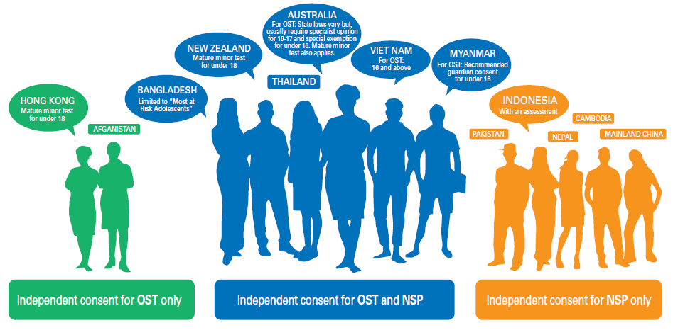
Countries enabling independent consent for young people to access harm reduction services, Asia and the Pacific
Source: UNICEF, UNESCO, UNFPA, UNODC, Youth LEAD, & Youth Voices Count. (2015). Adolescents Under the Radar in the Asia-Pacific AIDS Response.

Slide 31
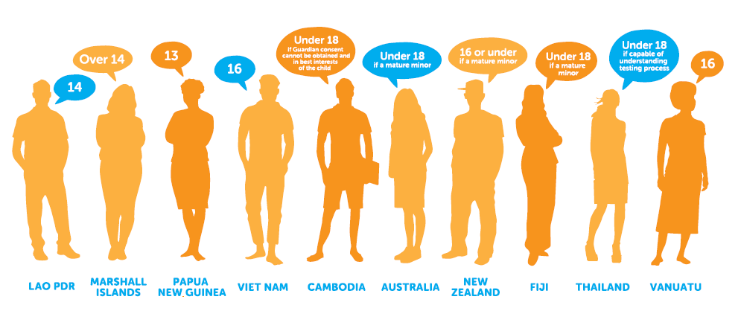
Where there are barriers – there will be less or no access to the health services
Age of legal capacity to consent independently to an HIV test, Asia and the Pacific
Source: UNICEF, UNESCO, UNFPA, UNODC, Youth LEAD, & Youth Voices Count. (2015). Adolescents Under the Radar in the Asia-Pacific AIDS Response.

Slide 32
Compared to their older counterparts,
less young key populations are being reached by prevention programmes
less young key populations have access to HIV testing services and approximately 1 in 3 young key populations do not know their HIV status

Slide 33
Proportion of sex workers who know their HIV status, 2014-2018
* FSW only; ** FSW, MSW and TG SW
Source: Prepared by www.aidsdatahub.org based on Behavioural Surveys; Integrated Biological and Behavioural Surveys; Global AIDS Response Progress Reporting; Global AIDS Monitoring 2017, 2018 and 2019

Slide 34
Proportion of MSM who know their HIV status, 2014 - 2018
Source: Prepared by www.aidsdatahub.org based on Behavioural Surveys; Integrated Biological and Behavioural Surveys; Global AIDS Response Progress Reporting; Global AIDS Monitoring (GAM) reporting

Slide 35
Proportion of young PWID who know their HIV status, 2014-2018
* very small sample size (<50) for young PWID; Thailand - very small sample size for young PWID and reported as “data not available”; ** Kathmandu
Source: Prepared by www.aidsdatahub.org based on Behavioural Surveys; Integrated Biological and Behavioural Surveys; Global AIDS Response Progress Reporting; Global AIDS Monitoring (GAM) reporting

Slide 36
Data issues

Slide 37
What do we need to know to prioritize populations for the AIDS response?
HIV-related risk in populations
Sexual risk: levels and frequency of unprotected vaginal and anal sex
Injection risk: sharing of needles
HIV and STI prevalence of sub-populations
Sizes of higher risk and vulnerable sub-populations
Geographic location of risk populations

Slide 38
Main data collection components of HIV/STI surveillance systems
Size estimates of key populations
Reported HIV and AIDS cases
HSS - HIV sentinel surveillance (facility-based)
BSS/IBBS - Bio-behavioral surveys in key populations (or general population)
STI Surveillance
Additional strategic information sources:
Mapping of sub-populations
Special surveys
Program M&E, other…

Slide 39
What is different about surveying young key populations (YKPs)?
The ethical considerations needed to include minors in studies that ask questions that relate to their sexual behavior, use of drugs and other risk behaviors

Slide 40
Only 9 out of 47 studies reviewed described ethical procedures specific for minors: Afghanistan, Cambodia, Indonesia, Lao PDR, Maldives, Pakistan, PNG, Thailand, Vanuatu
Ethical procedures for surveyed young populations
Ethical review and approval:
Weigh community benefit
Ethics approval granted for a person of any age to participate
Surveillance deemed as non-research activity by the Ethics Committee
Surveillance does not require Ethics Committee Review
Parental consent requirements:
Parent/ guardian consent required
Parent/ guardian consent waivered
Consent from Dept. of Education or school principal sufficient
Special adjustments for minors:
Protection of respondents built into design and questionnaires
Sensitive sexuality questions removed for very young students
Strategies to ensure consent secured without coercion
Referral to appropriate services.

Slide 41
Data need for young key populations
To understand how HIV affects young key populations…
Surveys have to include enough of young key populations to yield meaningful results
Reports of surveys have to include the age disaggregated data and results

Slide 42
Main data sources to generate key strategic information for young key populations
HIV and AIDS registry
Population
size estimates of key populations
HIV care and treatment programme data
HIV serological surveys
(HSS, IBBS, population based surveys and others)
STI and other co-infections surveillance
Behavioral surveys
(BSS, IBBS, population based surveys and others)
Additional strategic information sources*
* For instance, stigma index reports, NASA, AIDS spending matrix, programme monitoring and evaluation reports, and other special surveys
Source: Prepared by www.aidsdatahub.org

Slide 43
Issues around data collection and analysis
General issues
Variations of key populations definitions
Sampling methodology and comparability issues
Subpopulations with varying contexts (collect and analyse data together – eg, MSM and MSW, FSW and MSW, TG and MSM)
Availability of survey and programme reports
Young key populations specific
Access
Consent (for survey as well as for accessing health services eg -testing)
Ethical issues (inclusion criteria)
Issues around social and legal barriers (eg. Asking questions related to sexuality)
Other public health phenomena (such as unplanned pregnancies, GBV, drug abuse, STIs) linked to HIV risk
Analysis of age specific groups and reporting
Data for younger cohorts (10-14 yr)

Slide 44
THANK YOU
slides compiled by www.aidsdatahub.org
Data shown in this slide set are comprehensive to the extent they are available from country reports. Please inform us if you know of sources where more recent data can be used. Please acknowledge www.aidsdatahub.org if slides are lifted directly from this site

