Slide 1
People who inject drugs
Last updated: January 2022

Slide 2
CONTENT
Population size estimates
HIV prevalence and epidemiology
Risk behaviors
Vulnerability and HIV knowledge
National response

Slide 3
Population size estimates

Slide 4
People who inject drugs (PWID) population size estimates
Country | Estimated size | Definition | Males (15-49) | As% of males (15-49)
Afghanistan (2019) | 25,734 | Information not available | 9,596,723 | 0.27
Australia (2005) | 215,000 | Information not available | 5,822,784 | 3.7
Bangladesh (2015) | 33,067 (Total) 32,021 (Male) 1045 (Female) | Males who injected drugs within the last 1 year Females who injected drugs within the last 1 year | 43,789,365 | 0.08
Cambodia (2017) | 3,202 | Biological male at birth, 15-49 years old, who injected drug one or more time in the last month | 4,247,759 | 0.08
China (2013) | 1,930,000 | Persons who ever injected drugs | 397,300,323 | 0.5
India (2009)* | 177,000 | Information not available | 336,701,558 | 0.05
Indonesia (2019) | 34,517 | Persons who has a history of using narcotics and/or other injectable addictive substances in the past 1 year. | 73,407,113 | 0.05
Lao PDR (2019) | 1,661 | Information not available | 1,945,101 | 0.09
Malaysia (2018) | 75,000 | Current injectors who had been injecting drugs for at least six months | 9,173,055 | 0.82
Myanmar (2017) | 93,000 | Males 15+ yrs, who injected drugs for non-medical purposes in the past one month | 14,151,246 | 0.66
Nepal (2016) | 30,868 | People who inject various drugs into their muscles or veins for the purpose of intoxication in the last 12 months | 5,982,377 | 0.52
Pakistan (2016) | 113,776 | Persons 15+ yrs; who injected drugs regularly, for non-therapeutic purposes in the last 6 months | 53,596,310 | 0.21
Philippines (2019) | 7,400 | Males 15+ yrs; who injected drugs for non-medical purposes in the last six months | 28,957,687 | 0.03
Sri Lanka (2018)** | 2,672 | Persons who are currently injecting drugs | 4,972,656 | 0.05
Thailand (2015) | 42,650 | People who inject drugs at least once within the last month | 17,686,522 | 0.24
Viet Nam (2019) | 189,000 | Males 16 years or older, inject drug at least 1 time in the last month | 26,232,936 | 0.72
* India reported 2009 PWID population estimates in latest Global AIDS Monitoring (GAM) reporting; ** Based on mapping and enumeration, 2018.
Source: Global AIDS Monitoring reporting 2016 to 2020, China 2013 HIV estimation, and United Nations, Department of Economic and Social Affairs, Population Division (2020). World Population Prospects 2019

Slide 5
HIV prevalence and epidemiology

Slide 6
Need for focused response in HIV:
Epidemic mostly affecting key populations and their partners
Distribution of new HIV infections by population, 2020
94%
of new HIV infections among key populations and their partners
Sex workers
People who inject drugs
Men who have sex with men
Transgender women
Clients of sex workers and partners of key populations
Rest of population
Source: Prepared by www.aidsdatahub.org based on UNAIDS special analysis, 2021

Slide 7
HIV prevalence among people who inject drugs, 2012-2020
Source: Prepared by www.aidsdatahub.org based on Integrated Biological and Behavioral Surveillance Surveys; HIV Sentinel Surveillance Surveys and Global AIDS Monitoring

Slide 8
HIV prevalence among who inject drugs by gender, 2012-2020
* Male PWID – Dhaka and Hili; female PWID – Dhaka **Small sample size for female PWID
Source: Prepared by www.aidsdatahub.org based on 1) Integrated Biological and Behavioral Surveillance Surveys; 2) HIV Sentinel Surveillance Surveys; and 3) Global AIDS Monitoring

Slide 9
HIV prevalence among PWID in selected geographical locations with prevalence higher than national average, 2012-2020
HIV prevalence among people who inject drugs, 2012-2020
Source: Prepared by www.aidsdatahub.org based on HIV Sentinel Surveillance Surveys; Integrated Biological and Behavioral Surveillance Surveys and Global AIDS Monitoring

Slide 10
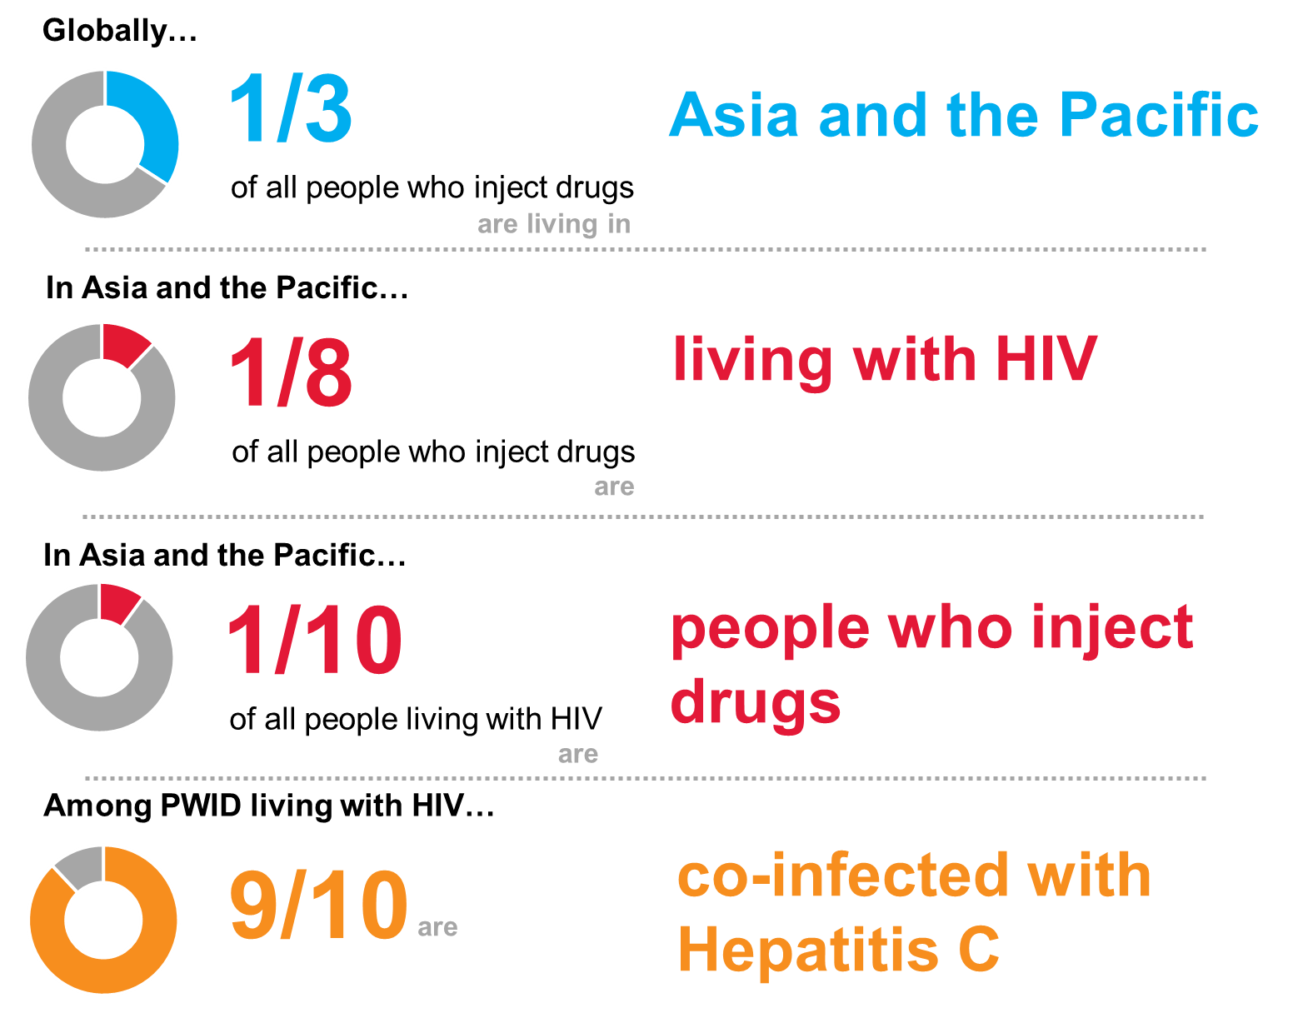
Double disease burden of HIV and HCV among PWID in Asia and the Pacific
Prepared by www.aidsdatahub.org based on Platt, L., Easterbrook, P., Gower, E., et al. Prevalence and burden of HCV co-infection in people living with HIV: a global systematic review and meta-analysis. The Lancet Infectious Diseases

Slide 11
HIV and HCV burden among PWID and population interactions with other populations - implications on onward transmissions
Half a million PWID living with HIV
4.1 M
PWID
430 K
HCV co-infection
51%
(33%- 70%)
27%
(10%- 42%)
14%
(4%-37%)
Note: HCV prevalence among PWID in the region varies with a range of 20% to 80%
Married or in partnership
Had sex with FSW
Had sex with males
Source: Prepared by www.aidsdatahub.org based on Integrated Behavior and Biological Surveillance (IBBS) and HIV sentinel surveillance plus (HSS+) reports and Platt, L., Easterbrook, P., Gower, E., et al. Prevalence and burden of HCV co-infection in people living with HIV: a global systematic review and meta-analysis. The Lancet Infectious Diseases

Slide 12
Hepatitis C and syphilis prevalence among PWID, countries where data is available, 2009-2018
Source: Prepared by www.aidsdatahub.org based on 1) Integrated Biological and Behavioral Surveillance Surveys and 2) HIV Sentinel Surveillance Surveys

Slide 13
Risk behaviors

Slide 14
Only one in three people who inject drugs used a condom during their last sexual encounter
Proportion of PWID who used a condom at last sex, 2015-2020
Source: Prepared by www.aidsdatahub.org based on Integrated Biological and Behavioral Surveillance surveys; Behavioral Surveillance Surveys and Global AIDS Monitoring

Slide 15
Condom use among both males and females who inject drugs is still below 90% in Asia and the Pacific
Condom use at last sex among PWID by gender, (2015-2020)
Source: Prepared by www.aidsdatahub.org based on Integrated Biological and Behavioral Surveillance surveys; Behavioral Surveillance Surveys and Global AIDS Monitoring

Slide 16
Safe injecting practices among people who inject drugs in Asia and the Pacific
Proportion of PWID reporting the use of sterile injecting equipment the last time they injected (2015-2020)
* Kathmandu; ** Cebu & Mandaue
Source: Prepared by www.aidsdatahub.org based on Integrated Biological and Behavioral Surveillance surveys; Behavioral Surveillance Surveys and Global AIDS Monitoring

Slide 17
No remarkable difference in safe injection practice among male and female PWID in countries where data is available
Safe injection practice among male and female PWID, 2015-2020
* Female PWID sample size <100
Source: Prepared by www.aidsdatahub.org based on Integrated Biological and Behavioral Surveillance surveys; Behavioral Surveillance Surveys and Global AIDS Monitoring

Slide 18
Proportion of PWID who reported safe injection practices, by age group,
2015 - 2020
<25 yr
25+ yr
%
Source: Prepared by www.aidsdatahub.org based on Integrated Biological and Behavioral Surveillance surveys; Behavioral Surveillance Surveys and Global AIDS Monitoring

Slide 19
The syndemic of HIV related risk and co-morbidities among women who use drug in Kuala Lumpur, Malaysia
Source: Prepared by www.aidsdatahub.org based on Loeliger, K. B., Marcus, R., Wickersham, J. A., et al. (2016). The syndemic of HIV, HIV-related risk and multiple co-morbidities among women who use drugs in Malaysia: Important targets for intervention. Addictive Behaviors, 53, 31-39

Slide 20
Average number of injections among people who inject drugs, 2011-2018
* Cebu and Mandaue; ** median value; ***More than 80% of all respondents injected 2-3 times a day.
Source: Prepared by www.aidsdatahub.org based on 1) Integrated Biological and Behavioral Surveillance Surveys; 2) Behavioral Surveillance Surveys;

Slide 21
Average duration of injecting drugs among PWID, 2012-2018
Source: Prepared by www.aidsdatahub.org based on 1) Integrated Biological and Behavioral Surveillance Surveys; 2) Behavioral Surveillance Surveys

Slide 22
Proportion of PWID who engaged in commercial sex in the past 12 months, 2012-2018
* ever had sex with FSW
**had sex with FSW in the past 6 months
Source: Prepared by www.aidsdatahub.org based on 1) Integrated Biological and Behavioral Surveillance Surveys; 2) Behavioral Surveillance Surveys

Slide 23
Proportion of PWID who reported consistent condom use, 2011-2017
Source: Prepared by www.aidsdatahub.org based on 1) Integrated Biological and Behavioral Surveillance Surveys; 2) Behavioral Surveillance Surveys

Slide 24
Vulnerability and
HIV knowledge

Slide 25
Proportion of PWID with comprehensive HIV knowledge, 2011-2019
Source: Prepared by www.aidsdatahub.org based on 1) Integrated Biological and Behavioral Surveillance Surveys; 2) Behavioral Surveillance Surveys

Slide 26
HIV expenditure

Slide 27
Key populations account for 98% of new HIV infections in Asia and the Pacific countries but less than half was spent for key populations HIV prevention programme
Proportion of prevention spending among key populations in Asia and the Pacific region
20 countries: Afghanistan, Bangladesh, Cambodia, India, Indonesia, Kiribati, Lao PDR, Malaysia, Myanmar, Nepal, Palau, Pakistan, Philippines, Samoa, Solomon Island, Sri Lanka, Thailand, Vanuatu, and Vietnam
Source: Prepared by www.aidsdatahub.org based on Global AIDS Response Progress and Global AIDS Monitoring (GAM) reporting

Slide 28
Prevention spending on key populations is heavily dependent on international financing sources
Prevention spending by financing source, 2012 - 2017
Note: Regional aggregate based on available data from 12 countries - Afghanistan, Bangladesh, Cambodia, Indonesia, Lao PDR, Malaysia, Myanmar, Nepal, Pakistan, Philippines, Thailand, Viet Nam - between 2012 and 2017
Prepared by www.aidsdatahub.org based on Global AIDS Monitoring Reporting, NASA reports

Slide 29
National response

Slide 30
Snapshot of harm reduction in Asia and the Pacific, 2020
 | Needle and syringe programmes operational | Needle and syringe programmes coverage | Possession of needle and syringe used as evidence for arrest | Opioid substitution therapy programmes operational | Opioid substitution therapy programmes coverage | Naloxone available through community distribution
Afghanistan | Yes |  | NO INFO | Yes |  | Yes
Australia | Yes |  | NO INFO | Yes |  | NO INFO
Bangladesh* | Yes |  | No | Yes |  | No
Cambodia | Yes |  | No | Yes |  | Yes
China | Yes |  | No | Yes |  | Yes
India | Yes |  | No | Yes |  | Yes
Indonesia | Yes |  | NO INFO | Yes |  | NO INFO
Lao PDR | Yes |  | No | No |  | No
Malaysia | Yes |  | No | Yes |  | Yes
Myanmar | Yes |  | No | Yes |  | No
Nepal | Yes |  | Yes | Yes |  | No
New Zealand | Yes |  | No | Yes |  | No
Pakistan | Yes |  | Yes | No |  | No
Philippines | No |  | Yes | No |  | No
Sri Lanka | No |  | No | No |  | No
Thailand | Yes |  | Yes | Yes |  | Yes
Viet Nam | Yes |  | NO INFO | Yes |  | NO INFO
Countries with HIV prevalence among PWID ≥ 5%
NSP programme coverage
(syringes per PWID per year)
High coverage: >200
Medium coverage: >100–<200
Low coverage: <100
No service
No info/ not reported
OST programme coverage
(% opioid injectors on OST)
High coverage: >40%
Medium coverage: 20 – ≤ 40%
Low coverage: < 20%
No service
No info/ not reported
* HIV prevalence from sentinel sites – Dhaka A1, A2 and Hili
Source: Prepared by www.aidsdatahub.org based on UNAIDS 2021 HIV Estimates and Global AIDS Monitoring

Slide 31
Needles and syringes distributed per PWID per year in Asia and the Pacific, 2019-2020
High coverage: ≥200 syringes per PWID per year
Medium coverage: ≥100–<200 syringes per PWID per year
Low coverage: <100 syringes per PWID per year
Source: Prepared by www.aidsdatahub.org based on Global AIDS Monitoring and UNAIDS. (2020). UNAIDS Data 2020

Slide 32
Coverage of opioid substitution therapy among people who inject drugs, 2020
High coverage: >40%
Medium coverage: 20 – ≤ 40%
Low coverage: <20%
Source: Prepared by www.aidsdatahub.org based on Global AIDS Monitoring

Slide 33
HIV testing coverage among people who inject drugs, 2014 - 2020
90%
* Programme data
Source: Prepared by www.aidsdatahub.org based on 1) Integrated Biological and Behavioral Surveillance Surveys ; 2. Behavioral Surveillance Surveys and 3) Global AIDS Monitoring

Slide 34
HIV testing coverage among male and female PWID, 2015-2020
* Female PWID sample size <100; ** Programme data
Source: Prepared by www.aidsdatahub.org based on Integrated Biological and Behavioral Surveillance Surveys; Behavioral Surveillance Surveys and Global AIDS Monitoring

Slide 35
HIV testing and treatment coverage, and response gap among PWID, select countries, 2017-2020
HIV testing coverage
Treatment coverage
China (2020)
88%
HIV testing coverage
Myanmar
(2017)
14%
Treatment coverage
Response gap
Viet Nam (2019)
64%
Source: Prepared by www.aidsdatahub.org based on Global AIDS Monitoring

Slide 36
Punitive laws hindering the HIV response among PWID in South Asia,
2014-2019
 | Corporal or capital punishment for drug offences | Compulsory center for PWID | Diversion from prisons to community service
Afghanistan
Bangladesh
Bhutan
India
Maldives
Nepal
Pakistan
Sri Lanka
The law or policy provides an enabling environment for HIV responses
Punitive law or policy; there is no enabling law or policy; the law or policy does not provide an enabling environment for HIV responses
Partially enabling; enabling but subject to significant limitations; some aspects of the law or policy are punitive
Information is unavailable or unclear
Sources: Prepared by www.aidsdatahub.org based on UNAIDS and UNDP. (2021). Legal and policy trends. Impacting people living with HIV and key populations in Asia and the Pacific, 2014-2019.

Slide 37
Punitive laws hindering the HIV response among PWID in South-East Asia, 2014-2019
 | Corporal or capital punishment for drug offences | Compulsory center for PWID | Diversion from prisons to community service
Brunei
Cambodia
Indonesia
Lao PDR
Malaysia
Myanmar
Philippines
Singapore
Thailand
Timor-Leste
Viet Nam
The law or policy provides an enabling environment for HIV responses
Punitive law or policy; there is no enabling law or policy; the law or policy does not provide an enabling environment for HIV responses
Partially enabling; enabling but subject to significant limitations; some aspects of the law or policy are punitive
Information is unavailable or unclear
Sources: Prepared by www.aidsdatahub.org based on UNAIDS and UNDP. (2021). Legal and policy trends. Impacting people living with HIV and key populations in Asia and the Pacific, 2014-2019.

Slide 38
Punitive laws hindering the HIV response among PWID in East Asia,
2014-2019
 | Corporal or capital punishment for drug offences | Compulsory center for PWID | Diversion from prisons to community service
China
Japan
Mongolia
DPR Korea
Republic of Korea
The law or policy provides an enabling environment for HIV responses
Punitive law or policy; there is no enabling law or policy; the law or policy does not provide an enabling environment for HIV responses
Partially enabling; enabling but subject to significant limitations; some aspects of the law or policy are punitive
Information is unavailable or unclear
Sources: Prepared by www.aidsdatahub.org based on UNAIDS and UNDP. (2021). Legal and policy trends. Impacting people living with HIV and key populations in Asia and the Pacific, 2014-2019.

Slide 39
Punitive laws hindering the HIV response among PWID in the Pacific, 2014-2019
 | Corporal or capital punishment for drug offences | Compulsory center for PWID | Diversion from prisons to community service
Fiji
Kiribati
Marshall Islands
FSM *
Nauru
PNG
Samoa
Solomon Islands
Tonga
Tuvalu
Vanuatu
The law or policy provides an enabling environment for HIV responses
Punitive law or policy; there is no enabling law or policy; the law or policy does not provide an enabling environment for HIV responses
Partially enabling; enabling but subject to significant limitations; some aspects of the law or policy are punitive
Information is unavailable or unclear
* Micronesia (Federated States of)
Sources: Prepared by www.aidsdatahub.org based on UNAIDS and UNDP. (2021). Legal and policy trends. Impacting people living with HIV and key populations in Asia and the Pacific, 2014-2019.

Slide 40
Punitive laws hindering the HIV response among PWID in South Asia,
2014-2019
 | OST provided through government approved programs | Young people can access OST without parental consent | NSP provided through government approved programs | Young people can access NSP without parental consent
Afghanistan
Bangladesh
Bhutan
India
Maldives
Nepal
Pakistan
Sri Lanka
Yes
No
Partial or ambiguous
No information
Sources: Prepared by www.aidsdatahub.org based on UNAIDS and UNDP. (2021). Legal and policy trends. Impacting people living with HIV and key populations in Asia and the Pacific, 2014-2019.

Slide 41
Punitive laws hindering the HIV response among PWID in South-East Asia, 2014-2019
 | OST provided through government approved programs | Young people can access OST without parental consent | NSP provided through government approved programs | Young people can access NSP without parental consent
Brunei
Cambodia
Indonesia
Lao PDR
Malaysia
Myanmar
Philippines
Singapore
Thailand
Timor-Leste
Viet Nam
Yes
No
Partial or ambiguous
No information
Sources: Prepared by www.aidsdatahub.org based on UNAIDS and UNDP. (2021). Legal and policy trends. Impacting people living with HIV and key populations in Asia and the Pacific, 2014-2019.

Slide 42
Punitive laws hindering the HIV response among PWID in East Asia,
2014-2019
 | OST provided through government approved programs | Young people can access OST without parental consent | NSP provided through government approved programs | Young people can access NSP without parental consent
China
Japan
Mongolia
DPR Korea
Republic of Korea
Yes
No
Partial or ambiguous
No information
Sources: Prepared by www.aidsdatahub.org based on UNAIDS and UNDP. (2021). Legal and policy trends. Impacting people living with HIV and key populations in Asia and the Pacific, 2014-2019.

Slide 43
Punitive laws hindering the HIV response among PWID in the pacific, 2014-2019
 | OST provided through government approved programs | Young people can access OST without parental consent | NSP provided through government approved programs | Young people can access NSP without parental consent
Fiji
Kiribati
Marshall Islands
FSM *
Nauru
PNG
Samoa
Solomon Islands
Tonga
Tuvalu
Vanuatu
Yes
No
Partial or ambiguous
No information
* Micronesia (Federated States of)
Sources: Prepared by www.aidsdatahub.org based on UNAIDS and UNDP. (2021). Legal and policy trends. Impacting people living with HIV and key populations in Asia and the Pacific, 2014-2019.

Slide 44
Punitive laws hindering the HIV response among people deprived of liberty in South Asia, latest available data, 2014-2019
 | Access to opioid-substitution therapy in prisons | Access to needle and syringe programmes in prisons | Access to condoms in prisons
Afghanistan
Bangladesh
Bhutan
India
Maldives
Nepal
Pakistan
Sri Lanka
Key
 | The law or policy provides an enabling environment for HIV response
 | Punitive law or policy; there is no enabling law or policy; the law or policy does not provide an enabling environment for HIV response
 | Partially enabling; enabling but subject to significant limitations; some aspects of the law or policy are punitive
 | Information is unavailable or unclear
Sources: Prepared by www.aidsdatahub.org based on UNAIDS and UNDP. (2021). Legal and policy trends. Impacting people living with HIV and key populations in Asia and the Pacific, 2014-2019.

Slide 45
Punitive laws hindering the HIV response among people deprived of liberty in South-East Asia, latest available data, 2014-2019
 | Access to opioid-substitution therapy in prisons | Access to needle and syringe programmes in prisons | Access to condoms in prisons
Brunei
Cambodia
Indonesia
Lao PDR
Malaysia
Myanmar
Philippines
Singapore
Thailand
Timor-Leste
Viet Nam
Key
 | The law or policy provides an enabling environment for HIV response
 | Punitive law or policy; there is no enabling law or policy; the law or policy does not provide an enabling environment for HIV response
 | Partially enabling; enabling but subject to significant limitations; some aspects of the law or policy are punitive
 | Information is unavailable or unclear
Sources: Prepared by www.aidsdatahub.org based on UNAIDS and UNDP. (2021). Legal and policy trends. Impacting people living with HIV and key populations in Asia and the Pacific, 2014-2019.

Slide 46
Punitive laws hindering the HIV response among people deprived of liberty in East Asia, latest available data, 2014-2019
 | Access to opioid-substitution therapy in prisons | Access to needle and syringe programmes in prisons | Access to condoms in prisons
China
Democratic People’s Republic of Korea
Japan
Mongolia
Republic of Korea
Key
 | The law or policy provides an enabling environment for HIV response
 | Punitive law or policy; there is no enabling law or policy; the law or policy does not provide an enabling environment for HIV response
 | Partially enabling; enabling but subject to significant limitations; some aspects of the law or policy are punitive
 | Information is unavailable or unclear
Sources: Prepared by www.aidsdatahub.org based on UNAIDS and UNDP. (2021). Legal and policy trends. Impacting people living with HIV and key populations in Asia and the Pacific, 2014-2019.

Slide 47
Punitive laws hindering the HIV response among people deprived of liberty in the Pacific, latest available data, 2014-2019
 | Access to opioid-substitution therapy in prisons | Access to needle and syringe programmes in prisons | Access to condoms in prisons
Fiji
Kiribati
Marshall Islands
Micronesia*
Nauru
PNG
Samoa
Solomon Islands
Tonga
Tuvalu
Vanuatu
Key
 | The law or policy provides an enabling environment for HIV response
 | Punitive law or policy; there is no enabling law or policy; the law or policy does not provide an enabling environment for HIV response
 | Partially enabling; enabling but subject to significant limitations; some aspects of the law or policy are punitive
 | Information is unavailable or unclear
* Micronesia (Federated States of)
Sources: Prepared by www.aidsdatahub.org based on UNAIDS and UNDP. (2021). Legal and policy trends. Impacting people living with HIV and key populations in Asia and the Pacific, 2014-2019.

Slide 48
THANK YOU
slides compiled by www.aidsdatahub.org
Data shown in this slide set are comprehensive to the extent they are available from country reports. Please inform us if you know of sources where more recent data can be used. Please acknowledge www.aidsdatahub.org if slides are lifted directly from this site

