Slide 1
Lao PDR
Last updated: February 2024

Slide 2
CONTENT
Basic socio-demographic indicators
HIV prevalence and epidemiological status
Risk behaviors
Vulnerability and HIV knowledge
HIV expenditure
National response

Slide 3
BASIC SOCIO-DEMOGRAPHIC INDICATORS
Total population (in thousands) | 6,802 (2015) ¹
Population aged 15-49 (thousands) | 3,605 (2015) ¹
Maternal mortality ratio (per 100 000 live births) | 197 (2015) ⁵
Percentage of population in urban areas | 39 (2015) ²
Antenatal care coverage - At least one visit (%) | 54.2 (2012) ⁷
Crude birth rate (births per 1,000 population) | 26.7 (2014) ²
Under-5 mortality rate (per 1,000 live births) | 67 (2015) ²
Human development index (HDI) - Rank/Value | 141/0.575 (2014) ⁴
Life expectancy at birth (years) - Male/Female | 64/67 (2015) ⁵
Adult literacy rate (%) | 73 (2005) ²
Ratio of girls to boys enrolled at primary level in public and private school (%) | 0.95 (2014) ²
GDP per capita (PPP, current international $) | 5,675 (2015) ²
Per capita total expenditure on health (PPP int. $) | 86 (2012) ³
Sources: Prepared by www.aidsdatahub.org based on 1. UN Population Division. (2015). World Population Prospects: The 2015 Revision - Extended Dataset; 2. World Bank. World Data Bank: World Development Indicators & Global Development Finance. Retrieved July 2016, from http://data.worldbank.org/; 3. WHO. (2015). World Health Statistics 2015; 4. Palanivel, T., Mirza, T., Tiwari, B. N., Standley, S., & Nigam, A. (2016). Asia-Pacific Human Development Report - Shaping the Future: How Changing Demographics Can Power Human Development; 5. WHO. (2016). World Health Statistics 2016: Monitoring health for the SDGs; 6. World Bank Group. (2016). World Development Indicators 2016 and 7. UNSD. Millennium Development Goals Database - Antenatal Care Coverage Retrieved May 2016, from http://data.un.org/Data.aspx?q=Antenatal+care+coverage&d=MDG&f=seriesRowID%3a762.

Slide 4
HIV prevalence and epidemiological status

Slide 5
Estimated people living with HIV, new HIV infections and AIDS-related deaths, 1990-2022
Source: Prepared by www.aidsdatahub.org based on UNAIDS HIV estimates 2023

Slide 6
Estimated number of adults (15+) living with HIV and women (15+) living with HIV, 1990-2022
Source: Prepared by www.aidsdatahub.org based on UNAIDS HIV estimates 2023

Slide 7
Key population size estimates, 2019-2020
Key population size estimates
Populations | Estimate | Year of estimate
People who inject drugs (PWID) | 1661 | 2019
Female sex workers (FSW) | 15 885 | 2020
Men who have sex with men (MSM) | 57 825 | 2020
Transgender people (TG) | 4627 | 2019
Source: Prepared by www.aidsdatahub.org based on Global AIDS Monitoring Reporting

Slide 8
HIV prevalence among key populations, 2012-2022
TRANSGENDER PEOPLE
(2012)
MEN WHO HAVE SEX
WITH MEN (2020)
PEOPLE WHO
INJECT DRUGS (2022)
FEMALE
SEX WORKERS (2020)
Source: Prepared by www.aidsdatahub.org based on Serological surveys and Global AIDS Monitoring (GAM) reporting

Slide 9
HIV prevalence among key populations, 2007-2022
Source: Prepared by www.aidsdatahub.org based on Serological surveys and Global AIDS Monitoring (GAM) reporting

Slide 10
HIV and STI prevalence among female sex workers, 2020
Source: Prepared by www.aidsdatahub.org based on Lao People’s Democratic Republic, Ministry of Health, Center for HIV/AIDS/STI (CHAS). Integrated Biological and Behavioral Survey among Female Sex Workers and Men Who Have Sex With Men in Lao PDR, 2020

Slide 11
Trends in STI prevalence among female sex worker in 6 round of sentinel surveillance, 2001-2020
Source: Prepared by www.aidsdatahub.org based on Center of HIV/AIDS/STI (CHAS), Lao PDR

Slide 12
HIV and STI prevalence among men who have sex with men, 2020
Source: Prepared by www.aidsdatahub.org based on Lao People’s Democratic Republic, Ministry of Health, Center for HIV/AIDS/STI (CHAS). Integrated Biological and Behavioral Survey among Female Sex Workers and Men Who Have Sex With Men in Lao PDR, 2020

Slide 13
Annual reported HIV cases, AIDS cases and deaths, 1990-2023
Source: Prepared by www.aidsdatahub.org based on Center of HIV/AIDS/STI (CHAS), Lao PDR

Slide 14
Reported HIV cases by gender and age group, 2023
Source: Prepared by www.aidsdatahub.org based on Center of HIV/AIDS/STI (CHAS), Lao PDR

Slide 15
Annual reported HIV cases by gender, 1990-2023
Source: Prepared by www.aidsdatahub.org based on Center of HIV/AIDS/STI (CHAS), Lao PDR

Slide 16
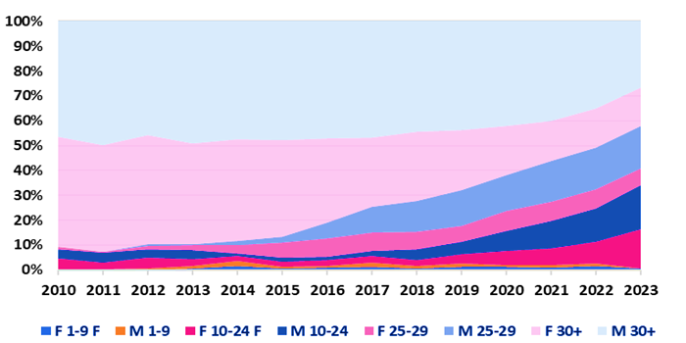
Reported HIV cases by gender and age group, 2010- Feb 2023
58% (aged < 30 years)
34% (aged < 25 years)
*
* as of February 2023
Source: Center of HIV/AIDS/STI (CHAS), Lao PDR, DHIS2 update Feb 2023

Slide 17
Proportion of HIV cases by mode of transmission, 2023
2066
reported HIV cases in 2023
* Including partners of key populations and PLHIV
Source: Prepared by www.aidsdatahub.org based on Center of HIV/AIDS/STI (CHAS), Lao PDR

Slide 18
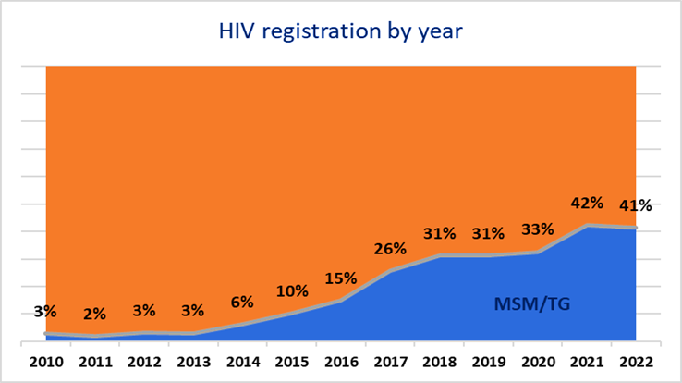
Trend in proportion of men who have sex with men and transgender among diagnosed HIV cases, 2010-2022
Men who have sex with men and transgender people
Source: Center of HIV/AIDS/STI (CHAS), Lao PDR, DHIS2 update Feb 2023

Slide 19
Risk behaviours

Slide 20
Proportion of key populations who reported condom use at last sex, 2007-2022
Source: Prepared by www.aidsdatahub.org based on 1) National Committee for the Control of AIDS Lao PDR. (2012). Lao PDR Global AIDS Response Progress Report, 2012, 2) Phimphachanh, C. (2010). Rapid Assessment and Response to Drug Use and Injecting Drug use in Huapganh and Phongsaly Provinces, Lao PDR. PowerPoint presentation presented at the Data Analysis Workshop, Vientiane, Lao PDR, and Center for HIV/AIDS/STI Lao PDR, USAID, Global Fund; 3) PSI (2012). Power Point Presentation at Consensus Meeting: Results of Second Round HIV/STI Prevalence and Behavioral Tracking Survey among Male-to-Female Transgender in Vientiane Capital and Savannakhet Lao PDR, 2012; and 4) Global AIDS Monitoring (GAM)

Slide 21
Frequency of condom use with casual male sex partners in past 12 months and past three months among MSM, 2020
Source: Prepared by www.aidsdatahub.org based on Lao People’s Democratic Republic, Ministry of Health, Center for HIV/AIDS/STI (CHAS). Integrated Biological and Behavioral Survey among Female Sex Workers and Men Who Have Sex With Men in Lao PDR, 2020

Slide 22
Frequency of condom use with male sex worker in past 12 months and past three months among MSM, 2020
Source: Prepared by www.aidsdatahub.org based on Lao People’s Democratic Republic, Ministry of Health, Center for HIV/AIDS/STI (CHAS). Integrated Biological and Behavioral Survey among Female Sex Workers and Men Who Have Sex With Men in Lao PDR, 2020

Slide 23
Frequency of condom use with paying male sex partners in past 12 months and past three months among MSM, 2020
Source: Prepared by www.aidsdatahub.org based on Lao People’s Democratic Republic, Ministry of Health, Center for HIV/AIDS/STI (CHAS). Integrated Biological and Behavioral Survey among Female Sex Workers and Men Who Have Sex With Men in Lao PDR, 2020

Slide 24
Frequency of condom use with regular male sex partners in past 12 months and past 3 months among MSM, 2020
Source: Prepared by www.aidsdatahub.org based on Lao People’s Democratic Republic, Ministry of Health, Center for HIV/AIDS/STI (CHAS). Integrated Biological and Behavioral Survey among Female Sex Workers and Men Who Have Sex With Men in Lao PDR, 2020

Slide 25
Proportion of surveyed men who have sex with men by age group and geographic location, 2020
Source: Prepared by www.aidsdatahub.org based on Lao People’s Democratic Republic, Ministry of Health, Center for HIV/AIDS/STI (CHAS). Integrated Biological and Behavioral Survey among Female Sex Workers and Men Who Have Sex With Men in Lao PDR, 2020

Slide 26
Proportion of condom use with most recent paid sexual partner among female sex workers, 2020
Source: Prepared by www.aidsdatahub.org based on Lao People’s Democratic Republic, Ministry of Health, Center for HIV/AIDS/STI (CHAS). Integrated Biological and Behavioral Survey among Female Sex Workers and Men Who Have Sex With Men in Lao PDR, 2020

Slide 27
Proportion of surveyed female sex workers by age group and geographic location, 2020
Source: Prepared by www.aidsdatahub.org based on Lao People’s Democratic Republic, Ministry of Health, Center for HIV/AIDS/STI (CHAS). Integrated Biological and Behavioral Survey among Female Sex Workers and Men Who Have Sex With Men in Lao PDR, 2020

Slide 28
Mean age at first sexual intercourse and first selling sex among female sex workers, 2020
Source: Prepared by www.aidsdatahub.org based on Lao People’s Democratic Republic, Ministry of Health, Center for HIV/AIDS/STI (CHAS). Integrated Biological and Behavioral Survey among Female Sex Workers and Men Who Have Sex With Men in Lao PDR, 2020

Slide 29
Vulnerability and
HIV knowledge

Slide 30
Comprehensive knowledge of HIV among men who have sex men, 2020
Source: Prepared by www.aidsdatahub.org based on Lao People’s Democratic Republic, Ministry of Health, Center for HIV/AIDS/STI (CHAS). Integrated Biological and Behavioral Survey among Female Sex Workers and Men Who Have Sex With Men in Lao PDR, 2020

Slide 31
Comprehensive knowledge of HIV among female sex workers, 2020
Source: Prepared by www.aidsdatahub.org based on Lao People’s Democratic Republic, Ministry of Health, Center for HIV/AIDS/STI (CHAS). Integrated Biological and Behavioral Survey among Female Sex Workers and Men Who Have Sex With Men in Lao PDR, 2020

Slide 32
HIV Expenditure

Slide 33
AIDS financing, 2022
AIDS spending by financing source
AIDS spending by service category
Domestic funding
45%
Key populations prevention
10%
Other prevention
5%
4.1
million US$
Care and treatment
16%
International funding
55%
Other AIDS expenditure
69%
Source: Prepared by www.aidsdatahub.org based on UNAIDS HIV Financial Dashboard

Slide 34
AIDS spending by financing source, 2006 - 2022
Source: Prepared by www.aidsdatahub.org based on UNAIDS HIV Financial Dashboard

Slide 35
National response

Slide 36
Proportion of key populations who received an HIV test in the last 12 months and know their results, 2007-2022
Source: Prepared by www.aidsdatahub.org based on 1) National Committee for the Control of AIDS Lao PDR. (2012). Lao PDR Global AIDS Response Progress Report, 2012; 2) Lao PDR Global AIDS Response Progress Reporting 2014 based on Results of Second Round HIV/STI Prevalence and Behavioral Tracking Survey among Male-to-Female Transgender in Vientiane Capital and Savannakhet Lao PDR, 2012; 3) Lao PDR Global AIDS Response Progress Reporting 2015 (Country Narrative Report); and 4) Global AIDS Monitoring Reporting

Slide 37
Proportion of female sex workers who received an HIV test in the last 12 months and know their results by surveyed city, 2020
95%
Source: Prepared by www.aidsdatahub.org based on Lao People’s Democratic Republic, Ministry of Health, Center for HIV/AIDS/STI (CHAS). Integrated Biological and Behavioral Survey among Female Sex Workers and Men Who Have Sex With Men in Lao PDR, 2020

Slide 38
Proportion of men who have sex with men who received an HIV test in the last 12 months and know their results by surveyed city, 2020
95%
Source: Prepared by www.aidsdatahub.org based on Lao People’s Democratic Republic, Ministry of Health, Center for HIV/AIDS/STI (CHAS). Integrated Biological and Behavioral Survey among Female Sex Workers and Men Who Have Sex With Men in Lao PDR, 2020

Slide 39
Pre-exposure prophylaxis (PrEP) scale up, 2020-2023
Increased by
32 times in 3 years
Source: Prepared by www.aidsdatahub.org based on Global AIDS Monitoring Reporting and Center of HIV/AIDS/STI (CHAS), Lao PDR

Slide 40
ART scale-up, 2000-2022
Source: Prepared by www.aidsdatahub.org based on Global AIDS Monitoring and UNAIDS HIV estimates 2023

Slide 41
Estimated adult (15+) living with HIV, people receiving ARVs, and ART coverage, 2022
Source: Prepared by www.aidsdatahub.org based on Global AIDS Monitoring and UNAIDS HIV estimates 2023

Slide 42
Treatment cascade, 2022
Source: Prepared by www.aidsdatahub.org based on Global AIDS Monitoring 2023

Slide 43
HIV testing and treatment cascade, 2022
Source: Prepared by www.aidsdatahub.org based on Global AIDS Monitoring 2023

Slide 44
PMTCT cascade, 2022
Source: Prepared by www.aidsdatahub.org based on UNAIDS HIV estimates 2023

Slide 45
Punitive and discriminatory laws, 2022
Criminalization of TG people | Criminalization of sex work | Criminalization of same-sex sexual acts | Law allows for possession of a certain limited amount of drugs for personal use | Parental consent for adolescents to access HIV testing | Laws or policies restricting the entry, stay and residence of people living with HIV
NO
YES
NO
NO
YES *
NO
* For adolescents <14 yr
Sources: Prepared by www.aidsdatahub.org based on UNAIDS. (2023). The path that ends AIDS: UNAIDS Global AIDS Update 2023. Geneva: Joint United Nations Programme on HIV/AIDS; 2023.

Slide 46
THANK YOU
slides compiled by www.aidsdatahub.org
Data shown in this slide set are comprehensive to the extent they are available from country reports. Please inform us if you know of sources where more recent data can be used.
Please acknowledge www.aidsdatahub.org if slides are lifted directly from this site

