Slide 1
India
Last updated: November 2021

Slide 2
CONTENT
Basic socio-demographic indicators
HIV prevalence and epidemiological status
Risk behaviors
Vulnerability and HIV knowledge
HIV expenditure
National response

Slide 3
BASIC SOCIO-DEMOGRAPHIC INDICATORS
Total population (in thousands) | 1,311,051 (2015) ¹
Population aged 15-49 (thousands) | 701,998 (2015) ¹
Maternal mortality ratio (per 100 000 live births) | 174 (2015) ⁵
Percentage of population in urban areas | 33 (2015) ²
Antenatal care coverage - At least one visit (%) | 74.2 (2006) ⁷
Crude birth rate (births per 1,000 population) | 20 (2014) ²
Under-5 mortality rate (per 1,000 live births) | 48 (2015) ²
Human development index (HDI) - Rank/Value | 130/0.609 (2014) ⁴
Life expectancy at birth (years) - Male/Female | 67/70 (2015) ⁵
Adult literacy rate (%) | 69 (2011) ²
Ratio of girls to boys enrolled at primary level in public and private school (%) | 1.12 (2013) ²
GDP per capita (PPP, current international $) | 6,089 (2015) ²
Per capita total expenditure on health (PPP int. $) | 267 (2014) ³
Sources: Prepared by www.aidsdatahub.org based on 1. UN Population Division. (2015). World Population Prospects: The 2015 Revision - Extended Dataset; 2. World Bank. World Data Bank: World Development Indicators & Global Development Finance. Retrieved July 2016, from http://data.worldbank.org/; 3. WHO. Global Health Observatory Indicator Views: Per Capita Total Expenditure on Health (PPP int. $) (Health Systems), Retrieved July 2016, from http://apps.who.int/gho/data/node.imr.WHS7_105?lang=en; 4. Palanivel, T., Mirza, T., Tiwari, B. N., Standley, S., & Nigam, A. (2016). Asia-Pacific Human Development Report - Shaping the Future: How Changing Demographics Can Power Human Development; 5. WHO. (2016). World Health Statistics 2016: Monitoring health for the SDGs; 6. World Bank Group. (2016). World Development Indicators 2016 and 7 . UNSD. Millennium Development Goals Database - Antenatal Care Coverage Retrieved May 2016, from http://data.un.org/Data.aspx?q=Antenatal+care+coverage&d=MDG&f=seriesRowID%3a762.

Slide 4
HIV prevalence and epidemiology

Slide 5
Snapshot of HIV infections and AIDS-related deaths, 2020
New HIV
infections
54,000
People living with HIV
2.3 million
Women living with HIV
1,000,000
Deaths
37,000
Source: Prepared by www.aidsdatahub.org based on Global AIDS Monitoring and UNAIDS HIV Estimates 2021

Slide 6
10 States accounted for 65% of new HIV infections and 78% of people living with HIV in India in 2019
Source: Prepared by www.aidsdatahub.org based on National AIDS Control Organization & ICMR-National Institute of Medical Statistics (2020). India HIV Estimates 2019: Report. New Delhi: NACO, Ministry of Health and Family Welfare, Government of India

Slide 7
Percentage change in new HIV infections from 2010 – 2019 by state
Source: Prepared by www.aidsdatahub.org based on National AIDS Control Organization & ICMR-National Institute of Medical Statistics (2020). India HIV Estimates 2019: Report. New Delhi: NACO, Ministry of Health and Family Welfare, Government of India

Slide 8
Percentage change in AIDS-related deaths from 2010-2019 by state
Source: Prepared by www.aidsdatahub.org based on National AIDS Control Organization & ICMR-National Institute of Medical Statistics (2020). India HIV Estimates 2019: Report. New Delhi: NACO, Ministry of Health and Family Welfare, Government of India

Slide 9
Key population size estimates, 2009-2013
Key population size estimates
Populations | Estimate | Year of estimate
People who inject drugs (PWID) | 177 000 | 2009
Female sex workers (FSW) | 868 000 | 2009
High-risk Men who have sex with men (MSM) | 357 000 | 2009
Transgender people (Hijra/TG) | 70 000 | 2013
Source: Prepared by www.aidsdatahub.org based on Global AIDS Monitoring 2018

Slide 10
HIV prevalence among key populations, 2003-2017
Source: Prepared by www.aidsdatahub.org based on 1) National AIDS Control Organization (2017). HIV Sentinel Surveillance: Technical Brief, India 2016-17. New Delhi: NACO, Ministry of Health and Family Welfare, Government of India.; and 2) National AIDS Control Organization (2015). National Integrated Biological and Behavioral Surveillance (IBBS), India 2014-15. New Delhi: NACO, Ministry of Health and Family Welfare, Government of India

Slide 11
HIV prevalence among sentinel populations, HSS reports 2008-2017
Source: Prepared by www.aidsdatahub.org based on National AIDS Control Organization (2017). HIV Sentinel Surveillance: Technical Brief, India 2016-17. New Delhi: NACO, Ministry of Health and Family Welfare, Government of India.

Slide 12
HIV prevalence among key populations, national and select states, 2016-2017
TRANSGENDER PEOPLE
(2016-2017)
MEN WHO HAVE SEX
WITH MEN
(2016-2017)
PEOPLE WHO
INJECT DRUGS (2016-2017)
FEMALE
SEX WORKERS (2016-2017)
Source: Prepared by www.aidsdatahub.org based on Serological surveys and Global AIDS Monitoring 2018

Slide 13
HIV prevalence among key populations in selected states, HSS 2017
Source: Prepared by www.aidsdatahub.org based on National AIDS Control Organization (2017). HIV Sentinel Surveillance: Technical Brief, India 2016-17. New Delhi: NACO, Ministry of Health and Family Welfare, Government of India.

Slide 14
HIV prevalence among key populations in selected states, IBBS 2014-15
Source: Prepared by www.aidsdatahub.org based on National AIDS Control Organization (2015). National Integrated Biological and Behavioral Surveillance (IBBS), India 2014-15. New Delhi: NACO, Ministry of Health and Family Welfare, Government of India.

Slide 15
HIV prevalence among male prisoners by state, 2019
Source: Prepared by www.aidsdatahub.org based on National AIDS Control Organization. HSS Plus 2019: Central Prison Sites. New Delhi: NACO, Ministry of Health and Family Welfare, Government of India; 2020

Slide 16
HIV prevalence among pregnant women, by state, 2019
Source: Prepared by www.aidsdatahub.org based on National AIDS Control Organization. (2020). ANC HSS 2019: Technical Report. New Delhi: NACO, Ministry of Health and Family Welfare, Government of India; 2020

Slide 17
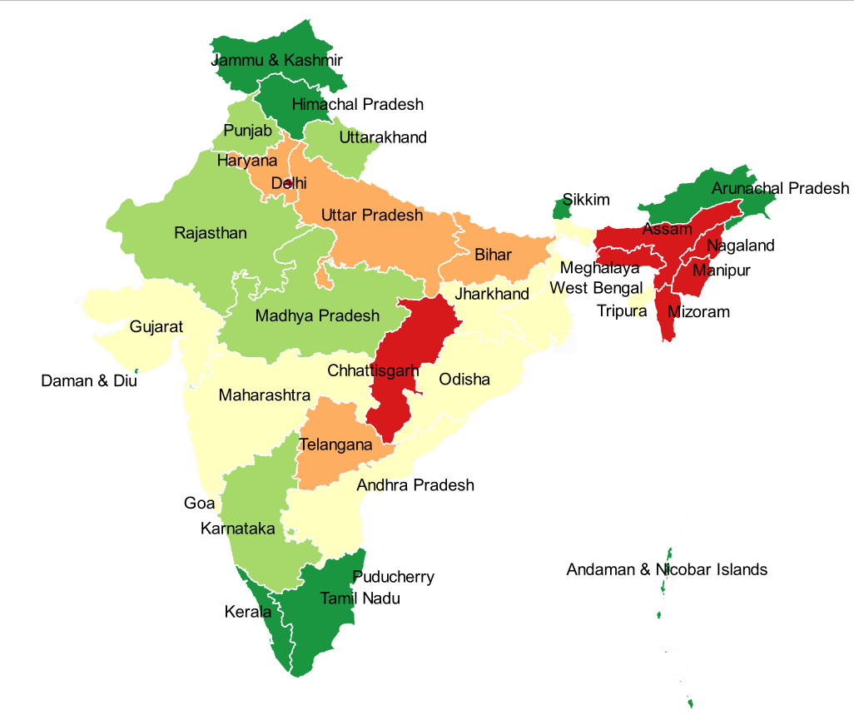
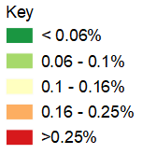
HIV seropositivity at NACO’s supported Blood Centres, by state, 2019-2020
Source: Prepared by www.aidsdatahub.org based on National AIDS Control Organization (2020). Sankalak: Status of National AIDS Response (Second edition, 2020). New Delhi: NACO, Ministry of Health and Family Welfare, Government of India.

Slide 18
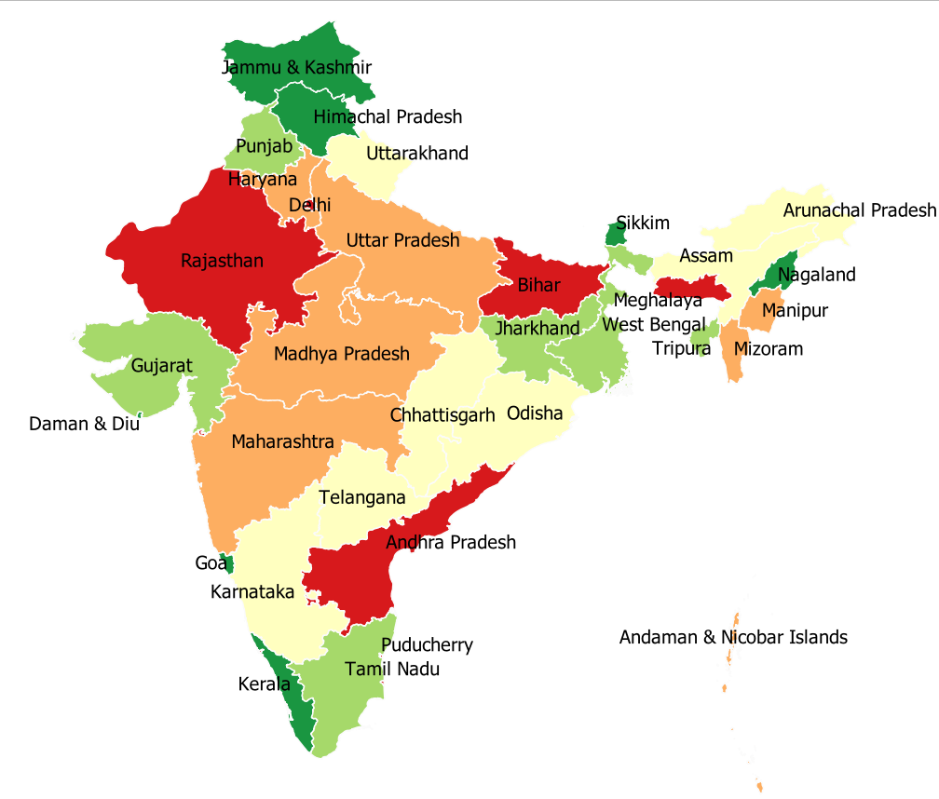
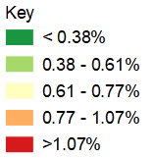
Hepatitis B seropositivity at NACO’s supported Blood Centres, by state, 2019-2020
Source: Prepared by www.aidsdatahub.org based on National AIDS Control Organization (2020). Sankalak: Status of National AIDS Response (Second edition, 2020). New Delhi: NACO, Ministry of Health and Family Welfare, Government of India.

Slide 19
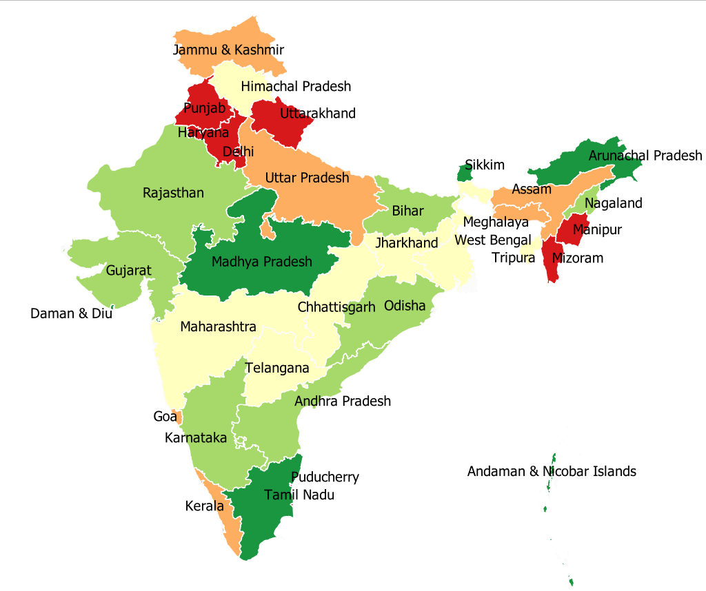
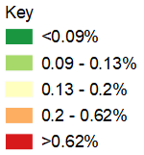
Hepatitis C seropositivity at NACO’s supported Blood Centres, by state, 2019-2020
Source: Prepared by www.aidsdatahub.org based on National AIDS Control Organization (2020). Sankalak: Status of National AIDS Response (Second edition, 2020). New Delhi: NACO, Ministry of Health and Family Welfare, Government of India.

Slide 20
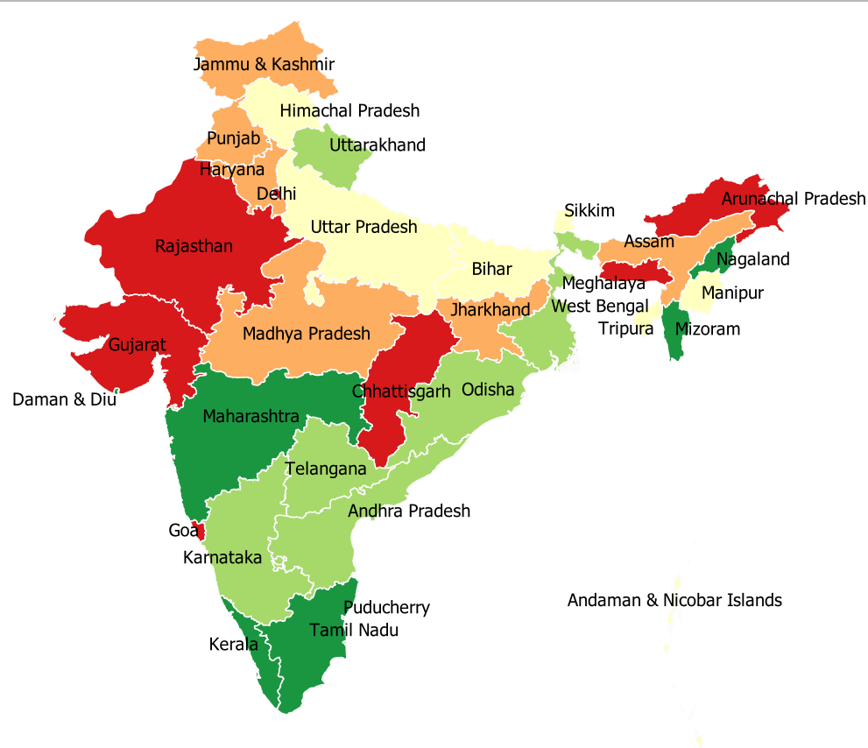
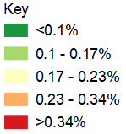
Syphilis seropositivity at NACO’s supported Blood Centres, by state, 2019-2020
Source: Prepared by www.aidsdatahub.org based on National AIDS Control Organization (2020). Sankalak: Status of National AIDS Response (Second edition, 2020). New Delhi: NACO, Ministry of Health and Family Welfare, Government of India.

Slide 21
Proportional distribution of self-reported HIV cases by route of transmission,
2017-2020
Source: Prepared by www.aidsdatahub.org based on National AIDS Control Organization (2020). Sankalak: Status of National AIDS Response (Second edition, 2020). New Delhi: NACO, Ministry of Health and Family Welfare, Government of India.

Slide 22
Risk behaviors

Slide 23
Proportion of key populations who reported condom use at last sex,
2014/15 – 2019/20
* With most recent client
** with commercial male partner
Source: Prepared by www.aidsdatahub.org based on www.unaids.aidsinfo.org/kpatlas citing IBBS 2014-2015; and National AIDS Control Organization. (2020). Behavioral Surveillance Survey-Lite: 2020 Top Line Findings

Slide 24
Proportion of FSW who reported condom use by partner type,
2014/15 - 2019/20
Source: Prepared by www.aidsdatahub.org based on National AIDS Control Organization (2015). National Integrated Biological and Behavioral Surveillance (IBBS), India 2014-15. New Delhi: NACO, Ministry of Health and Family Welfare, Government of India; and National AIDS Control Organization. (2020). Behavioral Surveillance Survey-Lite: 2020 Top Line Findings

Slide 25
Proportion of FSW who reported condom use at anal sex by partner type in 28 surveyed states, 2014-15
Note: Range represents the rates of condom use reported across the 28 surveyed States
State with lowest proportion of condom use
State with highest proportion of condom use
Source: Prepared by www.aidsdatahub.org based on National AIDS Control Organization (2015). National Integrated Biological and Behavioral Surveillance (IBBS), India 2014-15. New Delhi: NACO, Ministry of Health and Family Welfare, Government of India.

Slide 26
Proportion of MSM who reported condom use by partner type, 2014/15 – 2019/20
Note: IBBS 2014/15 and BSS 2019/20 is not comparable due to differences in methodology used
Source: Prepared by www.aidsdatahub.org based on National AIDS Control Organization (2015). National Integrated Biological and Behavioral Surveillance (IBBS), India 2014-15. New Delhi: NACO, Ministry of Health and Family Welfare, Government of India; and National AIDS Control Organization. (2020). Behavioral Surveillance Survey-Lite: 2020 Top Line Findings

Slide 27
Proportion of male PWID who reported condom use by partner type in
29 surveyed states, 2014-15
Note: Range represents the rates of condom use reported across the 29 States
State with lowest proportion of condom use
State with highest proportion of condom use
Source: Prepared by www.aidsdatahub.org based on National AIDS Control Organization (2015). National Integrated Biological and Behavioral Surveillance (IBBS), India 2014-15. New Delhi: NACO, Ministry of Health and Family Welfare, Government of India.

Slide 28
Proportion of MSM who reported condom use at last commercial sex, 2006-2015
Source: Prepared by www.aidsdatahub.org based on 1) Data received from UNAIDS India country office as part of preparation for the UNAIDS Regional Management Meeting, Bangkok, October 2012; and 2) National AIDS Control Organization (2015). National Integrated Biological and Behavioral Surveillance (IBBS), India 2014-15. New Delhi: NACO, Ministry of Health and Family Welfare, Government of India

Slide 29
Proportion of male PWID who reported the use of sterile injecting equipment at last injection, 2014-15
Source: Prepared by www.aidsdatahub.org based National AIDS Control Organization (2015). National Integrated Biological and Behavioral Surveillance (IBBS), India 2014-15. New Delhi: NACO, Ministry of Health and Family Welfare, Government of India

Slide 30
Trends in consistent condom use and HIV prevalence among MSM, 2001-2011
Source: Prepared by www.aidsdatahub.org based on 1. Mishra, R. M., Dube, M., et al. (2012). Changing epidemiology of HIV in Mumbai: An application of the Asian epidemic model. Glob J Health Sci, 4(5), 100-112.; 2.Avert Society. (2009). BSS Wave V: Maharashtra; Lan, W., Lu, W., et al. (2012).

Slide 31
Trends in consistent condom use among female sex workers with their clients, 2006-2010
Source: Prepared by www.aidsdatahub.org based on 1. Erausquin, J. T., Biradavolu, M., et al. (2012). Trends in condom use among female sex workers in Andhra Pradesh, India: the impact of a community mobilisation intervention. J Epidemiol Community Health, 66(2), 2011-200511; 2. Mishra, R. M., Dube, M., et al. (2012). Changing epidemiology of HIV in Mumbai: an application of the Asian epidemic model. Glob J Health Sci, 4(5), 100-112.

Slide 32
Proportion of surveyed key populations who are younger than 25, or are married, 2019-2020
Source: Prepared by www.aidsdatahub.org based on National AIDS Control Organization. (2020). Behavioral Surveillance Survey-Lite: 2020 Top Line Findings

Slide 33
Average duration of sex work among FSW, 2014-15
Source: Prepared by www.aidsdatahub.org based on National AIDS Control Organization (2015). National Integrated Biological and Behavioral Surveillance (IBBS), India 2014-15. New Delhi: NACO, Ministry of Health and Family Welfare, Government of India.

Slide 34
Proportion of male PWID with reported duration of injecting drug use behavior, 2014-15
Source: Prepared by www.aidsdatahub.org based on National AIDS Control Organization (2015). National Integrated Biological and Behavioral Surveillance (IBBS), India 2014-15. New Delhi: NACO, Ministry of Health and Family Welfare, Government of India.

Slide 35
Median duration of homosexual behavior among MSM, 2014-15
Source: Prepared by www.aidsdatahub.org based on National AIDS Control Organization (2015). National Integrated Biological and Behavioral Surveillance (IBBS), India 2014-15. New Delhi: NACO, Ministry of Health and Family Welfare, Government of India.

Slide 36
Proportion of young people (15-24 yr) who reported having sex before the age of 15, by age group and residence, 2015-16
Source: Prepared by www.aidsdatahub.org based on International Institute for Population Sciences (IIPS) and ICF. 2017. National Family Health Survey (NFHS-4), 2015-16: India. Mumbai: IIPS.

Slide 37
Vulnerability and HIV knowledge

Slide 38
Proportion of surveyed key populations with comprehensive HIV knowledge, 2019-2020
Source: Prepared by www.aidsdatahub.org based on National AIDS Control Organization. (2020). Behavioral Surveillance Survey-Lite: 2020 Top Line Findings; and National AIDS Control Organization. HSS Plus 2019: Central Prison Sites. New Delhi: NACO, Ministry of Health and Family Welfare, Government of India; 2020

Slide 39
Proportion of FSWs with comprehensive HIV knowledge by state, 2014-15
Source: Prepared by www.aidsdatahub.org based on National AIDS Control Organization (2015). National Integrated Biological and Behavioral Surveillance (IBBS), India 2014-15. New Delhi: NACO, Ministry of Health and Family Welfare, Government of India.

Slide 40
Proportion of MSM with comprehensive HIV knowledge by state, 2014-15
Source: Prepared by www.aidsdatahub.org based on National AIDS Control Organization (2015). National Integrated Biological and Behavioral Surveillance (IBBS), India 2014-15. New Delhi: NACO, Ministry of Health and Family Welfare, Government of India.

Slide 41
Proportion of PWID with comprehensive HIV knowledge by state, 2014-15
Source: Prepared by www.aidsdatahub.org based on National AIDS Control Organization (2015). National Integrated Biological and Behavioral Surveillance (IBBS), India 2014-15. New Delhi: NACO, Ministry of Health and Family Welfare, Government of India.

Slide 42
Proportion of male prisoners with comprehensive HIV knowledge by state, 2019
Source: Prepared by www.aidsdatahub.org based on National AIDS Control Organization. HSS Plus 2019: Central Prison Sites. New Delhi: NACO, Ministry of Health and Family Welfare, Government of India; 2020

Slide 43
Proportion of FSWs with comprehensive HIV knowledge, selected states, 2001 - 2015
Source: Prepared by www.aidsdatahub.org based on 1. National AIDS Control Organization India. (2008). National Behavioral Surveillance Survey (BSS) 2006: Female Sex Workers (FSWs) and their Clients, 2. Behavioral Surveillance Survey, 2009 cited in National AIDS Control Organization India. (2010). UNGASS Country Progress Report: India; and 3. National AIDS Control Organization (2015). National Integrated Biological and Behavioral Surveillance (IBBS), India 2014-15. New Delhi: NACO, Ministry of Health and Family Welfare, Government of India.

Slide 44
Proportion of key populations who reported experiencing physical and sexual violence in the last 12 months, 2014-15
Source: Prepared by www.aidsdatahub.org based on National AIDS Control Organization (2015). National Integrated Biological and Behavioral Surveillance (IBBS), India 2014-15. New Delhi: NACO, Ministry of Health and Family Welfare, Government of India.

Slide 45
Proportion of adult men and women with knowledge of HIV by age group and residence, 2015-2016
Source: Prepared by www.aidsdatahub.org based on International Institute for Population Sciences (IIPS) and ICF. 2017. National Family Health Survey (NFHS-4), 2015-16: India. Mumbai: IIPS.

Slide 46
HIV expenditure

Slide 47
AIDS financing, 2015-16
AIDS spending by financing source
AIDS spending by service category
Domestic funding
82%
Other AIDS expenditures
11%
Prevention *
51%
8.3
billion INR
* Prevention spending breakdown on key populations is not available
International funding
18%
Care and treatment
38%
Source: Prepared by www.aidsdatahub.org based on Global AIDS Response Progress Reporting 2016.

Slide 48
AIDS spending by financing source, 2007- March 2013
Source: Prepared by www.aidsdatahub.org based on National AIDS Control Organization India, Department of AIDS Control, & Ministry of Health & Family Welfare. (2014). Annual Report 2013-14.

Slide 49
AIDS spending by financing source, 2007- 2016
Source: Prepared by www.aidsdatahub.org based on National AIDS Control Organization India, Department of AIDS Control, & Ministry of Health & Family Welfare. (2014). Annual Report 2013-14; and Global AIDS Response Progress Reporting 2016.

Slide 50
AIDS spending by category, 2009-2012
Source: Prepared by www.aidsdatahub.org based on data received from UNAIDS India country office as part of preparation for the UNAIDS Regional Management Meeting, Bangkok, October 2012

Slide 51
Proportion of total prevention programme spending on key populations at higher risk, 2009-2012
Source: Prepared by www.aidsdatahub.org based on data received from UNAIDS India country office as part of preparation for the UNAIDS Regional Management Meeting, Bangkok, October 2012

Slide 52
National response

Slide 53
Proportion of key populations who received different HIV prevention services in the last 3 months, 2019-2020
Source: Prepared by www.aidsdatahub.org based on National AIDS Control Organization. (2020). Behavioral Surveillance Survey-Lite: 2020 Top Line Findings

Slide 54
Proportion of key populations who received an HIV test in the last 3 months, 2019-2020
Source: Prepared by www.aidsdatahub.org based on National AIDS Control Organization. (2020). Behavioral Surveillance Survey-Lite: 2020 Top Line Findings

Slide 55
Proportion of key populations who received an HIV test in the last 3 months, 2019-2020
* Including HIV testing
Source: Prepared by www.aidsdatahub.org based on National AIDS Control Organization. (2020). Behavioral Surveillance Survey-Lite: 2020 Top Line Findings

Slide 56
Number of Needle and Syringe Programme (NSP) and Opioid Substitution Therapy sites (OST), 2011–2020
Source: Prepared by www.aidsdatahub.org based on Global AIDS Response Progress Reporting; and National AIDS Control Organization (2020). Sankalak: Status of National AIDS Response (Second edition, 2020). New Delhi: NACO, Ministry of Health and Family Welfare, Government of India.

Slide 57
Number of needle/syringes distributed per person who inject drugs per year, 2008-2020
High coverage: >200 syringes per PWID per year
Medium coverage: >100–<200 syringes per PWID per year
Low coverage: <100 syringes per PWID per year
Source: Prepared by www.aidsdatahub.org based on 1) WHO, UNAIDS, & UNICEF. (2009). Towards Universal Access: Scaling up Priority HIV/AIDS Interventions in the Health Sector- Progress Report 2009; 2) WHO, UNAIDS, & UNICEF. (2010). Towards Universal Access: Scaling up Priority HIV/AIDS Interventions in the Health Sector - Progress Report 2010; 3) WHO, UNAIDS, & UNICEF. (2011). Global HIV/AIDS Response Epidemic Update and Health Sector Progress towards Universal Access Progress Report 2011; 4) National AIDS Control Organization India. (2012). Global AIDS Response Progress Report: India; and 5) Global AIDS Monitoring Reporting

Slide 58
Proportion of key populations who received an HIV test in the last 12 months and knew their results (Targeted Intervention programme data), 2011-2014
Source: Prepared by www.aidsdatahub.org based on 1) Programme data received from UNAIDS India country office as part of preparation for the UNAIDS Regional Management Meeting, Bangkok, October 2012; and 2) National Programme data- Targeted Intervention Programme data reported through CMIS – as cited in GARPR 2014.

Slide 59
HIV testing among key populations & other high-risk groups at Integrated Council and Testing Centers (ICTCs), October 2019 – March 2020
Source: Prepared by www.aidsdatahub.org based on National AIDS Control Organization (2020). Sankalak: Status of National AIDS Response (Second edition, 2020). New Delhi: NACO, Ministry of Health and Family Welfare, Government of India.

Slide 60
Distribution of centers providing ART by state, 2019-2020
India
553 ART centers
1,270 Link ART centers 1,823 Total centers
Source: Prepared by www.aidsdatahub.org based on National AIDS Control Organization (2020). Sankalak: Status of National AIDS Response (Second edition, 2020). New Delhi: NACO, Ministry of Health and Family Welfare, Government of India.

Slide 61
Treatment cascade, 2020
Source: Prepared by www.aidsdatahub.org based on Global AIDS Monitoring 2021 and UNAIDS 2021 HIV Estimates

Slide 62
ART scale up, 2004-2020
Source: Prepared by www.aidsdatahub.org based on UNAIDS HIV Estimates and Global AIDS Monitoring

Slide 63
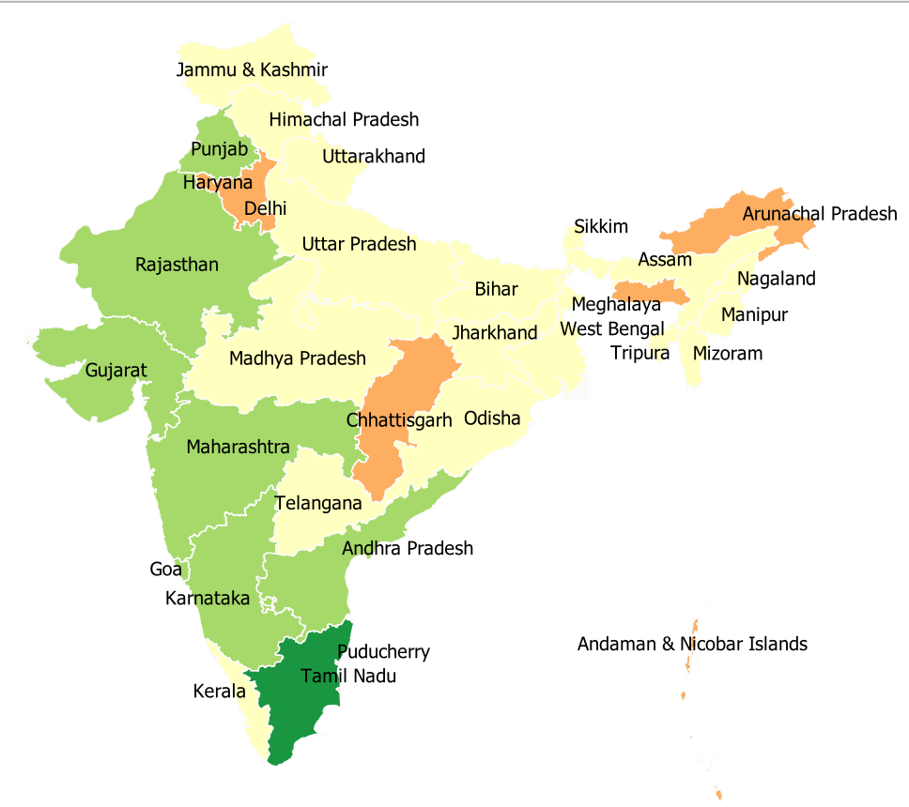
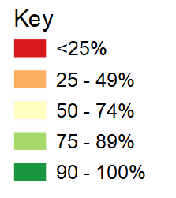
First 90: Proportion of PLHIV who know their HIV status, 2019-2020
Source: Prepared by www.aidsdatahub.org based on National AIDS Control Organization (2020). Sankalak: Status of National AIDS Response (Second edition, 2020). New Delhi: NACO, Ministry of Health and Family Welfare, Government of India.

Slide 64
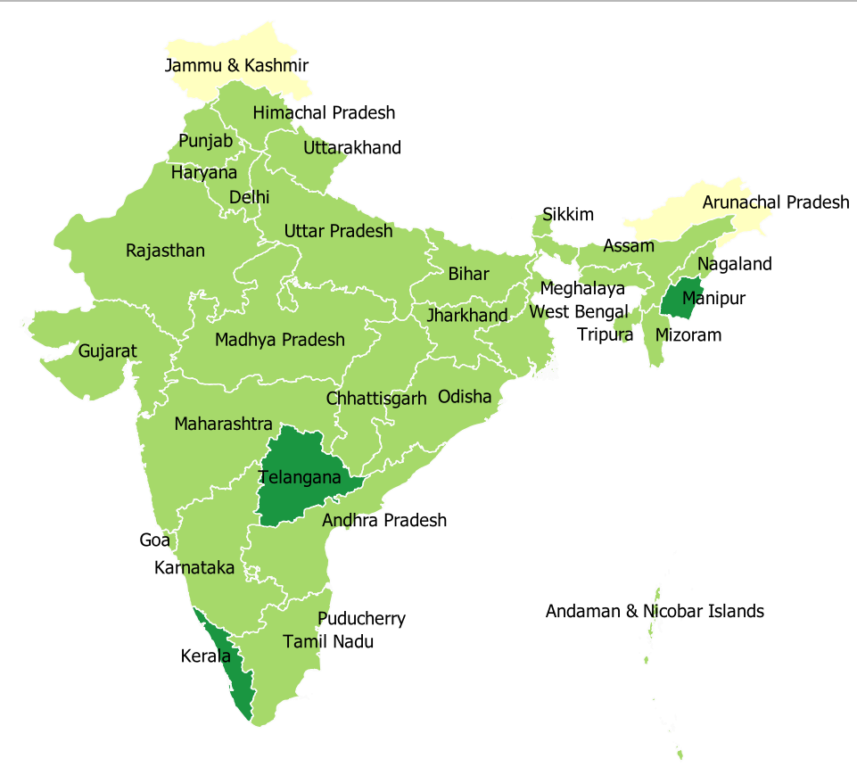
Second 90: Proportion of PLHIV who know their HIV status who are on ART, 2019-2020
Source: Prepared by www.aidsdatahub.org based on National AIDS Control Organization (2020). Sankalak: Status of National AIDS Response (Second edition, 2020). New Delhi: NACO, Ministry of Health and Family Welfare, Government of India.

Slide 65
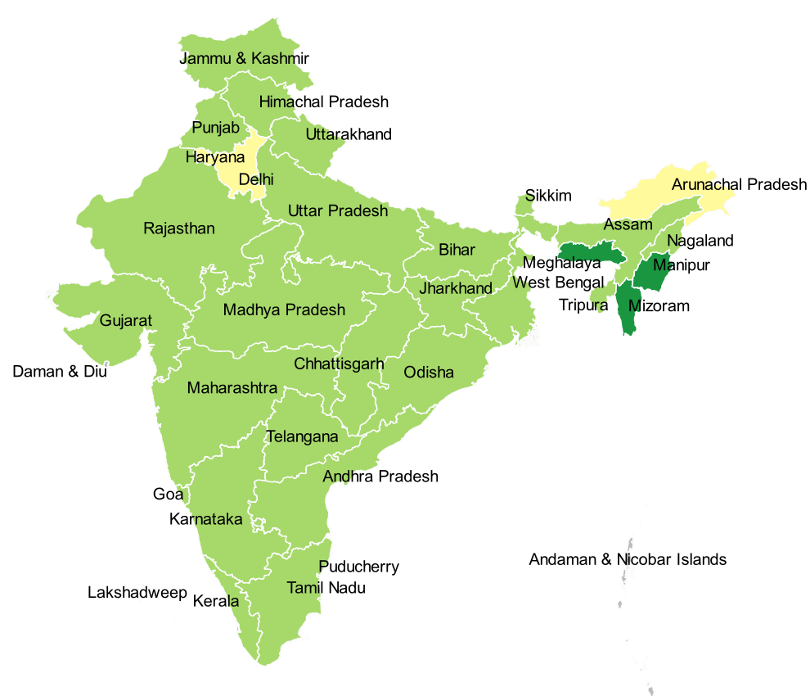
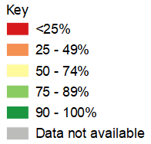
Third 90: Proportion of people on ART who have achieved viral suppression,
2019-2020
Source: Prepared by www.aidsdatahub.org based on National AIDS Control Organization (2020). Sankalak: Status of National AIDS Response (Second edition, 2020). New Delhi: NACO, Ministry of Health and Family Welfare, Government of India.

Slide 66
Estimated pregnant women living with HIV, pregnant women receiving ARVs, and PMTCT coverage, 2020
Source: Prepared by www.aidsdatahub.org based on Global AIDS Monitoring 2021 and UNAIDS 2021 HIV Estimates

Slide 67
HIV testing and treatment cascade, 2020
Source: Prepared by www.aidsdatahub.org based on Global AIDS Monitoring 2021 and UNAIDS 2021 HIV Estimates

Slide 68
PMTCT cascade, 2020
Source: Prepared by www.aidsdatahub.org based on Global AIDS Monitoring 2021 and UNAIDS 2021 HIV Estimates

Slide 69
Punitive and discriminatory laws, 2021
Criminalization of TG people | Criminalization of sex work | Criminalization of same-sex sexual acts | Law allows for possession of a certain limited amount of drugs for personal use | Parental consent for adolescents to access HIV testing | Laws or policies restricting the entry, stay and residence of people living with HIV
NO
YES
NO
YES
YES *
NO
* For adolescents <18 yr
Sources: Prepared by www.aidsdatahub.org based on UNAIDS. (2021). Global AIDS Update 2021. Confronting Inequalities: Lessons for pandemic responses from 40 years of AIDS.

Slide 70
THANK YOU
slides compiled by www.aidsdatahub.org
Data shown in this slide set are comprehensive to the extent they are available from country reports. Please inform us if you know of sources where more recent data can be used.
Please acknowledge www.aidsdatahub.org if slides are lifted directly from this site

