Slide 1
Brunei Darussalam
Last updated: September 2019

Slide 2
CONTENT
Basic socio-demographic indicators
HIV prevalence and epidemiological status
National response

Slide 3
BASIC SOCIO-DEMOGRAPHIC INDICATORS
Total population (in thousands) | 423 (2014) ⁴
Annual population growth rate | 1.3 (2014) ⁴
Population aged 15-49 (thousands) | 234 (2014) ⁴
Percentage of population in urban areas | 77 (2013) ³
Crude birth rate (births per 1,000 population) | 15.9 (2012) ³
Under-5 mortality rate (per 1,000 live births) | 8 (2012) ²
Human development index (HDI) - Rank/Value | 30/0.852 (2013) ¹
Life expectancy at birth (years) | 78.5 (2013) ¹
Adult literacy rate (%) | 95.4 (2005-2012) ¹
Ratio of girls to boys in primary and secondary education (%) | 99.9 (2012) ³
GDP per capita (PPP, $US) | 38,563 (2013) ³
Per capita total health expenditure (Int.$) | 1,179 (2011) ²
Sources: Prepared by www.aidsdatahub.org based on 1. UNDP. (2014). Human Development Report 2014 Sustaining Human Progress: Reducing Vulnerabilities and Building Resilience; 2. WHO. (2014). World Health Statistics 2014; 3. World Bank. World Data Bank: World Development Indicators & Global Development Finance. Retrieved October, 2014, from h​t​t​p​:​/​/​d​a​t​a​b​a​n​k​.​w​o​r​l​d​b​a​n​k​.​o​r​g​; and 4. UN Population Division. (2013). World Population Prospects: The 2012 Revision - Extended Dataset.

Slide 4
HIV prevalence and epidemiology

Slide 5
Cumulative HIV infections in Brunei, 1986-2018
Cumulative HIV infections by time period
245
cumulative HIV infections
in 2018
Number of HIV cases
Source: Prepared by www.aidsdatahub.org based on Ministry of Health, Brunei Darussalam, Health Information Booklets 2004 – 2017 and https://borneobulletin.com.bn/alarming-rise-in-hiv-cases-in-brunei-health-minister/
Notes:
Aug 1986

Slide 6
Annual reported HIV infections by district, 2004-2017
37
32
28
Source: Prepared by www.aidsdatahub.org based on Ministry of Health, Brunei Darussalam, Health Information Booklets 2004 – 2017

Slide 7
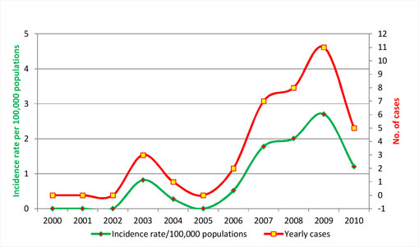
Number of reported new HIV infections and HIV incidence rate per 100,000 populations, 2000-2010
Source: Ministry of Health, Brunei Darussalam retrieved from http://www.moh.gov.bn/satisticshealthguidelines/statistics.htm

Slide 8
Reported number of cumulative HIV cases, people living with HIV, new HIV infections and AIDS-related deaths, 2013
Sources: Prepared by www.aidsdatahub.org based on Brunei Darussalam Global AIDS Response Progress Reporting 2014

Slide 9
Percent distribution of new HIV infections by gender and mode of transmission, 2013
Sources: Prepared by www.aidsdatahub.org based on Brunei Darussalam Global AIDS Response Progress Reporting 2014

Slide 10
National response

Slide 11
HIV testing and treatment cascade, 2018
Source: Prepared by www.aidsdatahub.org based on UNAIDS 2019 HIV Estimates and Global AIDS Monitoring 2019

Slide 12

Punitive laws hindering the HIV response in Brunei Darussalam
Sources: Prepared by www.aidsdatahub.org based on UNAIDS, UNDP, UNFPA, and UNODC. (2014). Punitive Laws Hindering the HIV Response in Asia and the Pacific in October 2014

Slide 13
THANK YOU
slides compiled by www.aidsdatahub.org
Data shown in this slide set are comprehensive to the extent they are available from country reports. Please inform us if you know of sources where more recent data can be used.
Please acknowledge www.aidsdatahub.org if slides are lifted directly from this site

