Slide 1
Bhutan
Last updated: September 2023

Slide 2
CONTENT
Basic socio-demographic indicators
HIV prevalence and epidemiology
Risk behaviors
Vulnerability and HIV knowledge
HIV expenditure
National response

Slide 3
BASIC SOCIO-DEMOGRAPHIC INDICATORS
Total population (in thousands) | 775 (2015) ¹
Population aged 15-49 (thousands) | 455 (2015) ¹
Maternal mortality ratio (per 100 000 live births) | 148 (2015) ⁵
Percentage of population in urban areas | 39 (2015) ²
Antenatal care coverage - At least one visit (%) | 97.9 (2012) ⁷
Crude birth rate (births per 1,000 population) | 17.7 (2014) ²
Under-5 mortality rate (per 1,000 live births) | 33 (2015) ²
Human development index (HDI) - Rank/Value | 132/0.605 (2014) ⁴
Life expectancy at birth (years) - Male/Female | 70/70 (2015) ⁵
Adult literacy rate (%) | 53 (2005) ²
Ratio of girls to boys enrolled at primary level in public and private school (%) | 1.01 (2014) ²
GDP per capita (PPP, current international $) | 8,077 (2015) ²
Per capita total expenditure on health (PPP int. $) | 281 (2014) ³
Sources: Prepared by www.aidsdatahub.org based on 1. UN Population Division. (2015). World Population Prospects: The 2015 Revision - Extended Dataset; 2. World Bank. World Data Bank: World Development Indicators & Global Development Finance. Retrieved July 2016, from http://data.worldbank.org/; 3. WHO. Global Health Observatory Indicator Views: Per Capita Total Expenditure on Health (PPP int. $) (Health Systems), Retrieved July 2016, from http://apps.who.int/gho/data/node.imr.WHS7_105?lang=en; 4. Palanivel, T., Mirza, T., Tiwari, B. N., Standley, S., & Nigam, A. (2016). Asia-Pacific Human Development Report - Shaping the Future: How Changing Demographics Can Power Human Development; 5. WHO. (2016). World Health Statistics 2016: Monitoring health for the SDGs; 6. World Bank Group. (2016). World Development Indicators 2016 and 7. UNSD. Millennium Development Goals Database - Antenatal Care Coverage Retrieved May 2016, from http://data.un.org/Data.aspx?q=Antenatal+care+coverage&d=MDG&f=seriesRowID%3a762.

Slide 4
HIV prevalence and epidemiology

Slide 5
Estimated people living with HIV, new HIV infections and AIDS-related deaths, 1990-2022
Source: Prepared by www.aidsdatahub.org based on UNAIDS HIV estimates 2023

Slide 6
Estimated number of adults (15+) living with HIV and women (15+) living with HIV, 1990-2022
Source: Prepared by www.aidsdatahub.org based on UNAIDS HIV estimates 2023

Slide 7
Annual reported HIV cases,1993 - 2022
Source: Prepared by www.aidsdatahub.org based on National HIV, AIDS & STIs Control Program Department of Public Health, Ministry of Health, Bhutan

Slide 8
Cumulative diagnosed HIV cases 2006 - 2022
Source: Prepared by www.aidsdatahub.org based on National HIV, AIDS & STIs Control Program Department of Public Health, Ministry of Health, Bhutan

Slide 9
Number of HIV tests Vs diagnosed HIV cases 2006 - 2022
Source: Prepared by www.aidsdatahub.org based on National HIV, AIDS & STIs Control Program Department of Public Health, Ministry of Health, Bhutan

Slide 10
Number of cumulative HIV infections by age group and gender, 1993 – 2019
Source: Prepared by www.aidsdatahub.org based on National HIV, AIDS & STIs Control Program Department of Public Health, Ministry of Health, Bhutan

Slide 11
Proportion of cumulative HIV infections by mode of transmission, 1993 – Nov 2021
795
cumulative HIV cases as of Nov 2021
Source: Prepared by www.aidsdatahub.org based on National HIV, AIDS & STIs Control Program Department of Public Health, Ministry of Health, Bhutan

Slide 12
Newly diagnosed and cumulative HIV cases in Bhutan, 1993- Nov 2021
Reported new HIV cases
Cumulative HIV cases by sex
795
cumulative HIV cases as of Nov 2021
Source: Prepared by www.aidsdatahub.org based on National HIV, AIDS & STIs Control Program Department of Public Health, Ministry of Health, Bhutan

Slide 13
Risk behaviours

Slide 14
Proportion of venue-based female sex workers and high-risk women who reported consistent condom use by type of partner, 2020
Source: Prepared by www.aidsdatahub.org based on National STIs and HIV/AIDS Prevention and Control Programme. (2020). Mapping and population size estimation of men who have sex with men, transgender persons, and high-risk women in Bhutan

Slide 15
Proportion of men who have sex with men and transgender women who reported consistent condom use by type of partner, 2020
Source: Prepared by www.aidsdatahub.org based on National STIs and HIV/AIDS Prevention and Control Programme. (2020). Mapping and population size estimation of men who have sex with men, transgender persons, and high-risk women in Bhutan

Slide 16
Vulnerability and HIV knowledge

Slide 17
Proportion of key populations who experienced discrimination when accessing health services, 2021
*Caution in interpretation is needed with small sample sizes, TGW sample size <50, TGM sample size <100.
Source: Prepared by www.aidsdatahub.org based on National AIDS/STI Control Programme Bhutan. (2021). HIV Sentinel Surveillance among Key Populations in Bhutan, 2021. NACP, Thimphu, Bhutan, 14 June 2021.

Slide 18
Proportion of surveyed populations with comprehensive HIV knowledge, 2008
Source: Prepared by www.aidsdatahub.org based on National AIDS/STI Control Programme Bhutan. (2009). Behavioural Surveillance Survey, 2008 Bhutan - Technical Report

Slide 19
Proportion of surveyed women with comprehensive HIV knowledge, 2010
Source: Prepared by www.aidsdatahub.org National Statistics Bureau, UNICEF, & UNFPA. (2011). Bhutan Multiple Indicator Survey 2010.

Slide 20
Proportion of young people with misconceptions on HIV transmission and treatment, 2006
Source: Prepared by www.aidsdatahub.org based on WHO. (2006). Fact Sheet on Young People and HIV/AIDS in Bhutan.

Slide 21
HIV Expenditure

Slide 22
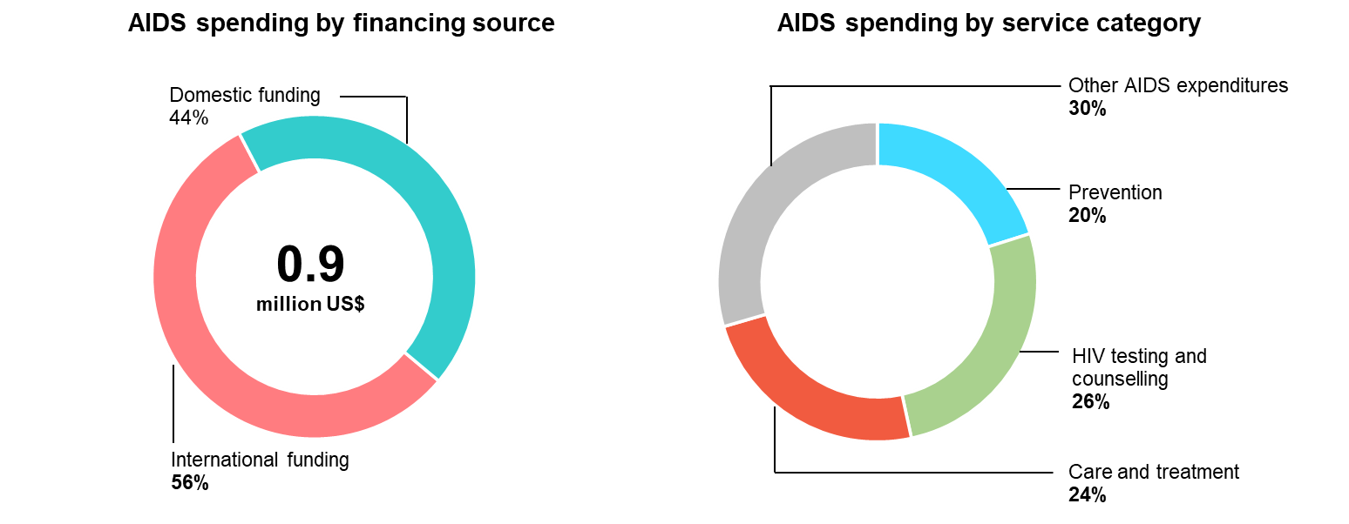
AIDS financing, 2018
Source: Prepared by www.aidsdatahub.org based on Global AIDS Monitoring and NASA 2016-2018

Slide 23
Bhutan Government co-financing contributions, 2018-2024.
Source: National HIV, AIDS & STIs Control Program Department of Public Health, Ministry of Health, Bhutan

Slide 24
Trend in GF funding support
Source: National HIV, AIDS & STIs Control Program Department of Public Health, Ministry of Health, Bhutan

Slide 25
Trends in WHO and UNICEF funding allocation to HIV and AIDS, 2015-2020
Source: National HIV, AIDS & STIs Control Program Department of Public Health, Ministry of Health, Bhutan

Slide 26
National response

Slide 27
Proportion of key populations tested for HIV in the past year, 2021
*Caution in interpretation is needed with small sample sizes, TGW sample size <50, TGM sample size <100.
Source: Prepared by www.aidsdatahub.org based on National AIDS/STI Control Programme Bhutan. (2021). HIV Sentinel Surveillance among Key Populations in Bhutan, 2021. NACP, Thimphu, Bhutan, 14 June 2021.

Slide 28
Treatment cascade, 2022
Source: Prepared by www.aidsdatahub.org based on UNAIDS HIV estimates 2023

Slide 29
HIV testing and treatment cascade, women (aged 15+ years) compared to men (aged 15+ years), 2022
Source: Prepared by www.aidsdatahub.org based on UNAIDS 2023 HIV Estimates

Slide 30
HIV testing and treatment cascade, 2022
Source: Prepared by www.aidsdatahub.org based on UNAIDS HIV estimates 2023

Slide 31
ART scale-up, 2000 - 2022
Source: Prepared by www.aidsdatahub.org based on UNAIDS. (2023). UNAIDS HIV estimates 2023

Slide 32
Number of ART sites and number of people on ART, 2000 - 2022
Source: Prepared by www.aidsdatahub.org based on 1. UNAIDS HIV Estimates 2023; 2. National AIDS Control Programme. (2015). Country Progress Report on the HIV Response in Bhutan-2015; and 3. Bhutan Global AIDS Response Progress Reporting, and Global AIDS Monitoring

Slide 33
PMTCT cascade, 2022
* Estimated number of women living with HIV who delivered within the past 12 months
Source: Prepared by www.aidsdatahub.org based on UNAIDS HIV estimates 2023

Slide 34
Punitive and discriminatory laws, 2022
Criminalization of TG people | Criminalization of sex work | Criminalization of same-sex sexual acts | Law allows for possession of a certain limited amount of drugs for personal use | Parental consent for adolescents to access HIV testing | Laws or policies restricting the entry, stay and residence of people living with HIV
NO INFORMATION AVAILABLE
NO INFORMATION AVAILABLE
NO
YES
NO
NO
Sources: Prepared by www.aidsdatahub.org based on UNAIDS. (2023). The path that ends AIDS: UNAIDS Global AIDS Update 2023. Geneva: Joint United Nations Programme on HIV/AIDS; 2023.

Slide 35
THANK YOU
slides compiled by www.aidsdatahub.org
Data shown in this slide set are comprehensive to the extent they are available from country reports. Please inform us if you know of sources where more recent data can be used.
Please acknowledge www.aidsdatahub.org if slides are lifted directly from this site

