Slide 1
Hong Kong, SAR

Slide 2

Content
Basic socio-demographic indicators
HIV prevalence and epidemiological status (1984-2011)
Risk behaviors (1998-2009)
Vulnerability and HIV knowledge (2000-2004)
National Response (1985-2009)
Archives

Slide 3
Basic socio-demographic indicators
Total population (in thousands) | 7,069 (2010)¹
Annual population growth rate | 0.9% (2010-2015)¹
Population aged 15-49 (thousands) | 3,792 (2010)²
Percentage of population in urban areas | 100 (2010)³
Crude birth rate (births per 1,000 population) | 11.7 (2009)⁴
Under-5 mortality rate (per 1,000 live births) | N/A
Human development index (HDI) - Rank/Value | 21/0.862 (2010)⁵
Life expectancy at birth (years) | 82.5 (2010)⁵
Adult literacy rate | N/A
Ratio of girls to boys in primary and secondary education (%) | 102% (2009)⁶
GDP per capita (PPP, $US) | 44,303 (2008)⁴
Source: 1. UN Statistics Division. (2010). Demographic and Social Statistics. Retrieved 10 January 2011, from http://unstats.un.org/unsd/demographic/products/socind/population.htm 2. UN Population Division. (2011). World Population Prospects, the 2010 Revision. Retrieved 10 January 2011, from http://esa.un.org/unpd/wpp/Excel-Data/population.htm 3. UNFPA. (2010). State of World Population 2010.
4. World Bank. World Development Indicators & Global Development Finance. Retrieved 10 January 2011, from http://databank.worldbank.org/ddp/home.do?Step=12&id=4&CNO=2 5. UNDP. (2010). Human Development Report 2010. 6. World Bank. World Development Indicators: Ratio of Girls to Boys in Primary and Secondary Education (%). Retrieved 10 Jan 2011, from http://data.worldbank.org/indicator/SE.ENR.PRSC.FM.ZS

Slide 4
HIV prevalence and epidemiological status

Slide 5
Cumulative number of HIV infections and AIDS cases, 1984 – March 2011
Source: Prepared by www.aidsdatahub.org based on 1. Special Preventive Programme, Centre for Health Protection, Department of Health. (2011). HIV/AIDS Situation in Hong Kong [2010] Factsheet. and 2. Special Preventive Programme, Centre for Health Protection, Department of Health Hong Kong. (2011). Hong Kong STD/AIDS Update: A Quarterly Surveillance Report Vol. 17 No. 1 Quarter 1 2011

Slide 6
Annual new HIV infections by gender, 1984- March 2011
Source: Prepared by www.aidsdatahub.org based on 1. Wong Ka-hing, Department of Health. Press Meeting Presentation 26 May 2009 and 2. Special Preventive Programme, Centre for Health Protection, Department of Health Hong Kong. (2011). Hong Kong STD/AIDS Update: A Quarterly Surveillance Report Vol. 17 No. 1 Quarter 1 2011

Slide 7
Annually reported HIV infections and AIDS cases by gender, 2000 – March 2011
HIV infections
AIDS cases
Source: Prepared by www.aidsdatahub.org based on Special Preventive Programme, Centre for Health Protection, Department of Health Hong Kong. (2011). Hong Kong STD/AIDS Update: A Quarterly Surveillance Report Vol. 17 No. 1 Quarter 1 2011.

Slide 8
Cumulative reported HIV infections and AIDS cases by age group and gender, March 2011
HIV infections
AIDS cases
Source: Prepared by www.aidsdatahub.org based on Special Preventive Programme, Centre for Health Protection, Department of Health Hong Kong. (2011). Hong Kong STD/AIDS Update: A Quarterly Surveillance Report Vol. 17 No. 1 Quarter 1 2011.

Slide 9
Percent distribution of reported new HIV infections by mode of transmission, 2000 – March 2011
Source: Prepared by www.aidsdatahub.org based on Special Preventive Programme, Centre for Health Protection, Department of Health Hong Kong. (2011). Hong Kong STD/AIDS Update: A Quarterly Surveillance Report Vol. 17 No. 1 Quarter 1 2011.

Slide 10
Percent distribution of cumulative HIV infections by mode of transmission, 1984 - March 2011
Source: Prepared by www.aidsdatahub.org based on Special Preventive Programme, Centre for Health Protection, Department of Health Hong Kong. (2011). Hong Kong STD/AIDS Update: A Quarterly Surveillance Report Vol. 17 No. 1 Quarter 1 2011.

Slide 11
Annual number of HIV cases reported among heterosexual men and MSM, 1995-2008
Source: Prepared by www.aidsdatahub.org based on Special Preventive Programme, Centre for Health Protection, Department of Health Hong Kong. (2008). Fact Sheet: HIV/AIDS Situation in Hong Kong [2008].

Slide 12
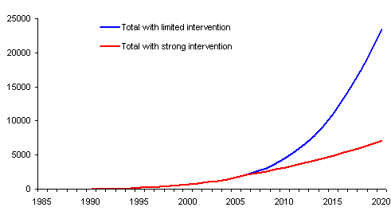
Comparison of expected number of current infections in Hong Kong with and without a strong intervention programme for MSM
(Number)
Year
Source: Brown, T. (2006). HIV/AIDS in Hong Kong: Living on the Edge. Honolulu, USA: East-West Center.

Slide 13
HIV prevalence among MSM, social hygiene service attendees and TB & chest clinic attendees, 2000 - 2008
Source: Prepared by www.aidsdatahub.org based on Special Preventive Programme Centre for Health Protection Department of Health Hong Kong. (2009). Hong Kong HIV Surveillance Report – 2008 Update.

Slide 14
HIV prevalence among newly admitted prisoners, TB & chest clinic attendees and drug treatment center attendees, 2000-2008
Source: Prepared by www.aidsdatahub.org based on Special Preventive Programme, Centre for Health Protection, Department of Health. (2009). Hong Kong HIV Surveillance Report – 2008 Update.

Slide 15
Risk behaviours

Slide 16
% of FSWs who used a condom at last vaginal sex with client and over 50% condom use with their clients in last 7 days, 2006 and 2009
Source: Prepared by www.aidsdatahub.org based on 1. Special Preventive Programme, Centre for Health Protection, Department of Health. (2007). CRiSP-Community Based Risk Behavioural and Seroprevalence Survey for Female Sex Workers in Hong Kong 2006 Factsheet. and 2. Special Preventive Programme, Centre for Health Protection, Department of Health. (2010). CRiSP-Community Based Risk Behavioural and Seroprevalence Survey for Female Sex Workers in Hong Kong 2009 Factsheet.

Slide 17
% of MSM who reported always using condoms during anal sex in the last six months by type of partner, 2006 and 2008
Source: Prepared by www.aidsdatahub.org based on Special Preventive Programme, Centre for Health Protection, Department of Health. (2009). PRiSM - HIV Prevalence and Risk behavioural Survey of Men who have sex with men in Hong Kong 2008 Factsheet.

Slide 18
Condom use among MSMs attending government AIDS counseling and testing service, 1998-2005
Source: Prepared by www.aidsdatahub.org based on Special Preventive Programme, Department of Health, as cited in Stanley Ho Centre for Emerging Infectious Diseases, & The Chinese University of Hong Kong. (2007). Report on the Assessment of Recently Acquired HIV Infection in MSM in Hong Kong.

Slide 19
% of MSM who reported the consistent condom use during commercial and non-commercial sex, 2001
(%)
100
Note: Respondents were MSM who had anal sex, n=72
50
42.9
35.7
0
Commercial sex
Non-commercial sex
Source: Prepared by www.aidsdatahub.org based on J T F Lau, J H Kim, M Lau, & Tsui, H.-Y. (2004). HIV Related Behaviors and Attitudes among Chinese MSM in Hong Kong: A Population Based Study. Sex Transm Infect , 80: 459-465.

Slide 20
Selected risky behaviors among newly admitted and readmitted clients of methadone service, 1999-2005
Notes: Sample sizes: 5106 new admissions; 35585 readmissions. New admission: first time registering clients; Readmission: clients who have dropped out of the methadone service for 28 days or more
Source: Prepared by www.aidsdatahub.org based on Li, H., Goggins, W., & Lee, S. S. (2009). Multilevel Analysis of HIV Related Risk Behaviors among Heroin Users in a Low Prevalence Community. BMC Public Health, 9.

Slide 21
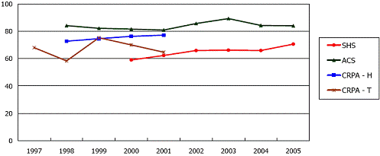
Regular condom use with female sex workers among adult heterosexual men, 2000-2005
(%)
SHS: Social Hygiene Services
ACS: AIDS Counseling Service
CRPA: Community Research Programme on AIDS, Center for Epidemiology and Biostatistics
Data from CRPA is suspended since 2002. H: household survey; T: Travelers survey
Source: Special Preventive Programme, Centre for Health Protection, Department of Health, Hong Kong SAR. (2006). HIV Surveillance Report – 2005 Update.

Slide 22
Vulnerability and HIV knowledge

Slide 23
% of key affected populations with comprehensive HIV knowledge, 2004
Source: Prepared by www.aidsdatahub.org based on Hong Kong Advisory Council on AIDS. (2007). Recommended HIV/AIDS Strategies for Hong Kong 2007-2011.

Slide 24
% of MSM engaged in unprotected sex in last 6 months who disagreed with these statements, 2001
(%)
You have a total control in deciding whether to use condom
50
Among the peers you know, most of them would use condom during sexual intercourse
45.9
40
32.8
30
29.0
28.8
20
18.1
14.9
10
0
Not engaged in anal sex
(n=220)
Engaged in anal sex
(n=72)
Total
(n=292)
Source: Prepared by www.aidsdatahub.org based on J T F Lau, J H Kim, M Lau, & Tsui, H.-Y. (2004). HIV Related Behaviors and Attitudes among Chinese MSM in Hong Kong: A Population Based Study. Sex Transm Infect , 80: 459-465.

Slide 25
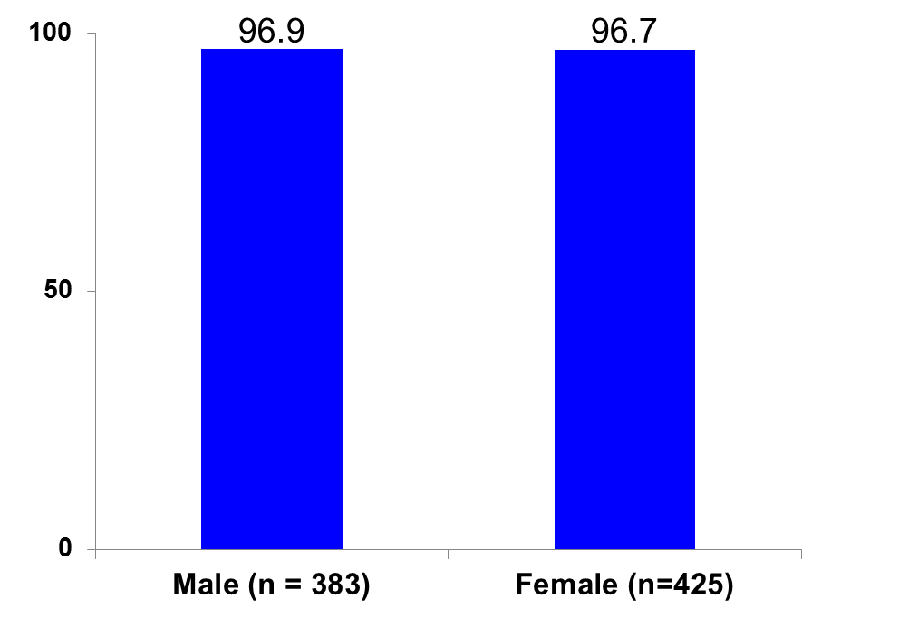
% of population (18-50) willing to take care of a family member who is HIV infected, 2000
(%)
Source: Prepared by www.aidsdatahub.org based on Lau JT, & Tsui HY. (2005). Discriminatory Attitudes Towards People Living with HIV/AIDS and Associated Factors: A Population Based Study in the Chinese General Population. Sex Transm Infect. , 81(2), 113-119.

Slide 26
National response

Slide 27
% of key affected populations who received an HIV test in the last 12 months and knew the results, 2001-2009
Sources: Prepared by www.aidsdatahub.org based on 1. Hong Kong Advisory Council on AIDS. (2007). Recommended HIV/AIDS Strategies for Hong Kong 2007-2011. 2. Special Preventive Programme, Centre for Health Protection, Department of Health. (2009). PRiSM - HIV Prevalence and Risk behavioural Survey of Men who have sex with men in Hong Kong 2008 Factsheet 3. Special Preventive Programme, Centre for Health Protection, Department of Health. (2010). CRiSP-Community Based Risk Behavioural and Seroprevalence Survey for Female Sex Workers in Hong Kong 2009 Factsheet. and 4. State Council AIDS Working Committee Office China (2010). UNGASS Country Progress Report: China.

Slide 28
Number of MSM having undergone voluntary HIV testing and % tested positive at AIDS Concern’s MSM voluntary HIV testing service, 2000 - 2008
Source: Prepared by www.aidsdatahub.org based on Special Preventive Programme, Centre for Health Protection, Department of Health, Hong Kong SAR. (2009). HIV Surveillance Report – 2008 Update.

Slide 29
Number of urine samples tested and % tested positive among methadone clinic attendees through universal HIV antibody (urine) testing programme, 2003-2008
Source: Prepared by www.aidsdatahub.org based on Special Preventive Programme, Centre for Health Protection, Department of Health, Hong Kong SAR. (2009). HIV Surveillance Report – 2008 Update.

Slide 30
Number of urine samples tested and % tested positive among drug users attending treatment centers/ institutions through unlinked anonymous screening, 1998-2008
Source: Prepared by www.aidsdatahub.org based on Special Preventive Programme, Centre for Health Protection, Department of Health, Hong Kong SAR. (2009). HIV Surveillance Report – 2008 Update.

Slide 31
Number of blood and urine samples tested and % tested positive among newly admitted prisoners through unlinked anonymous screening, 1995-2008
Source: Prepared by www.aidsdatahub.org based on Special Preventive Programme, Centre for Health Protection, Department of Health, Hong Kong SAR. (2009). HIV Surveillance Report – 2008 Update.

Slide 32
Number of urine samples tested and % tested positive among TB and chest clinic attendees through unlinked anonymous screening, 1995-2008
Source: Prepared by www.aidsdatahub.org based on Special Preventive Programme, Centre for Health Protection, Department of Health, Hong Kong SAR. (2009). HIV Surveillance Report – 2008 Update.

Slide 33
Number of TB and chest clinic attendees having undergone voluntary HIV testing and % tested positive, 1995-2008
Source: Prepared by www.aidsdatahub.org based on Special Preventive Programme, Centre for Health Protection, Department of Health, Hong Kong SAR. (2009). HIV Surveillance Report – 2008 Update.

Slide 34
Number of social hygiene service attendees having undergone voluntary HIV testing and % tested positive, 1985-2008
Source: Prepared by www.aidsdatahub.org based on Special Preventive Programme, Centre for Health Protection, Department of Health, Hong Kong SAR. (2009). HIV Surveillance Report – 2008 Update.

Slide 35
Number of pregnant women tested for HIV and % tested positive through universal antenatal HIV testing programme, 2001-2008
Source: Prepared by www.aidsdatahub.org based on Special Preventive Programme, Centre for Health Protection, Department of Health, Hong Kong SAR. (2009). HIV Surveillance Report – 2008 Update.

Slide 36
Formulation of HIV and AIDS Strategies by the Hong Kong Advisory Council on AIDS, 1994-2011
Year | Formulation
1994 | Strategies for AIDS Prevention, Care and Control in Hong Kong
1999 | AIDS Strategies for Hong Kong, 1999-2001
2002 | Recommended HIV/AIDS Strategies in Hong Kong 2002-2006
2007-2011 | Recommended HIV/AIDS Strategies for Hong Kong 2007-2011
Source: Hong Kong Advisory Council on AIDS. (2007). Recommended HIV/AIDS Strategies for Hong Kong 2007-2011.

Slide 37
THANK YOU
slides compiled by www.aidsdatahub.org
Data shown in this slide set are comprehensive to the extent they are available from country reports. Please inform us if you know of sources where more recent data can be used.
Please acknowledge www.aidsdatahub.org if slides are lifted directly from this site

